Slide 1


Introduction to Game Development:
Legend of Royal Institution

Slide 2
What makes up a video game
Technical aspects of developing games
Practice
Further reading and recommendations

Slide 3
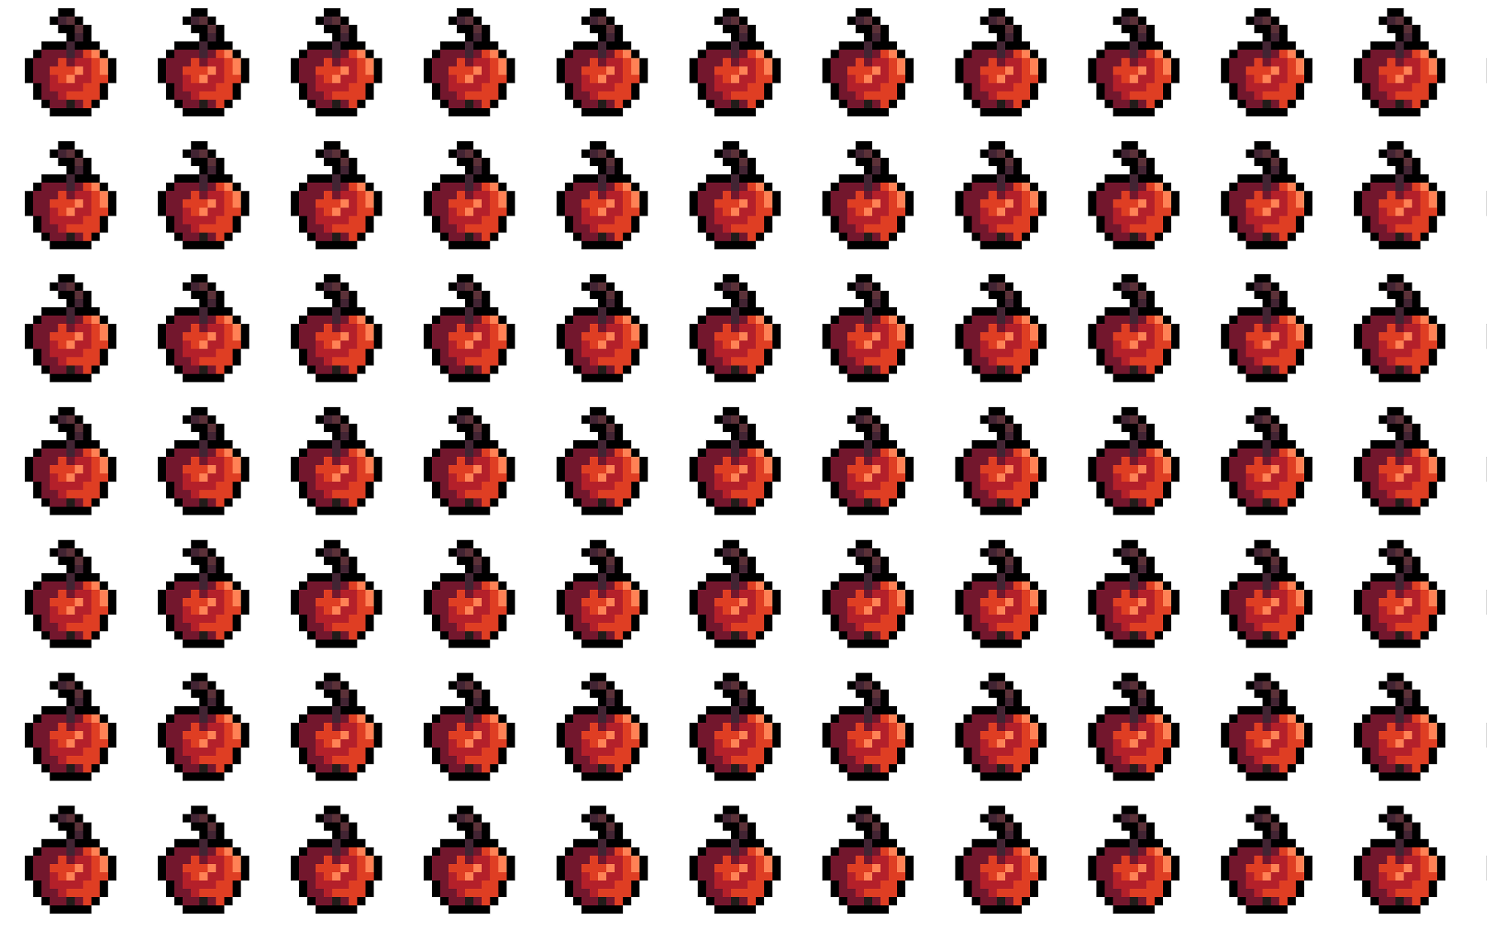
What makes up a video game

Slide 4
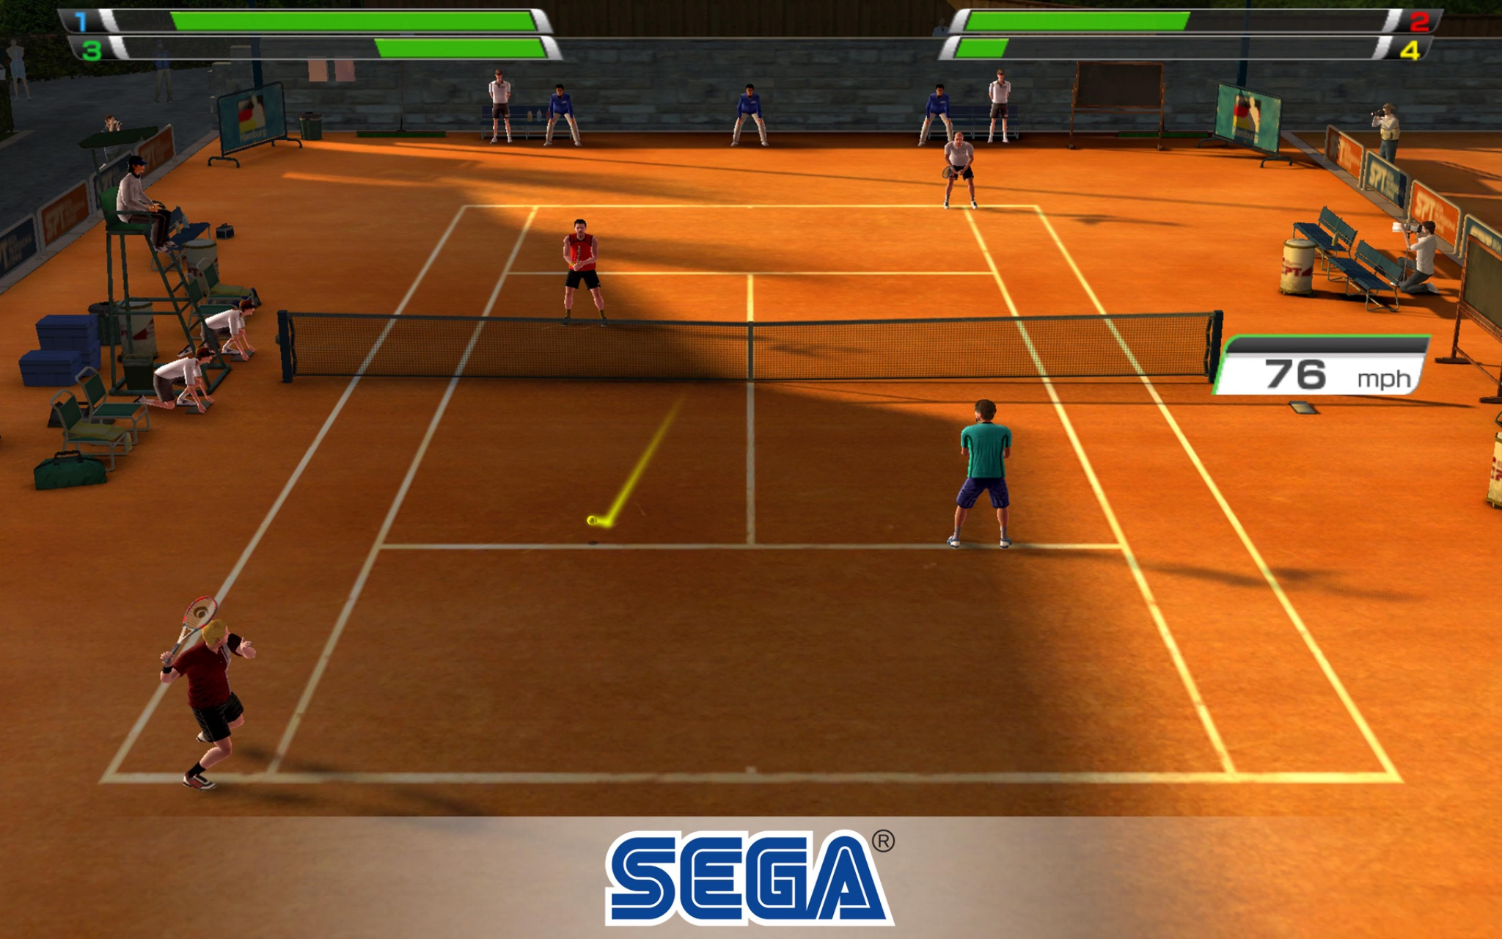

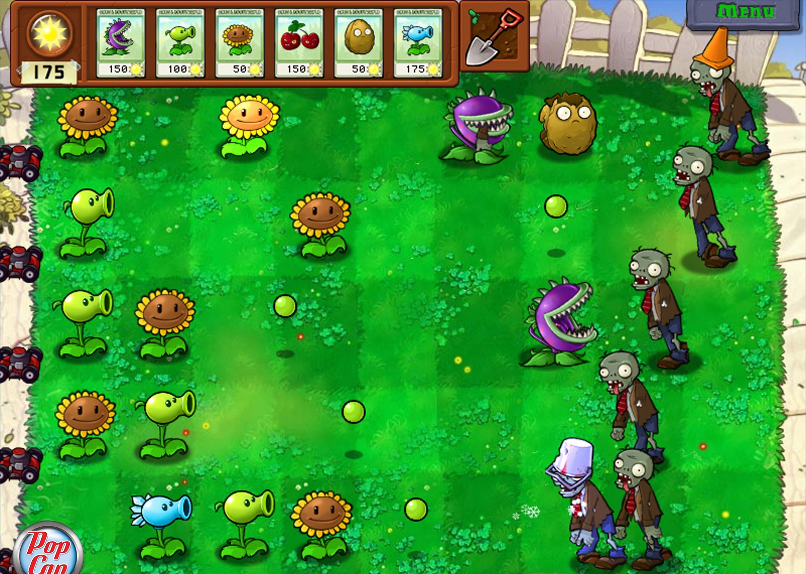
Formulae of a game
Q: What makes game a game?
Game = ??? + ??? + ???
*Images courtesy of Sega Corporation, Xbox Game Studios,
Electronic Arts Inc. (top to bottom)

Slide 5
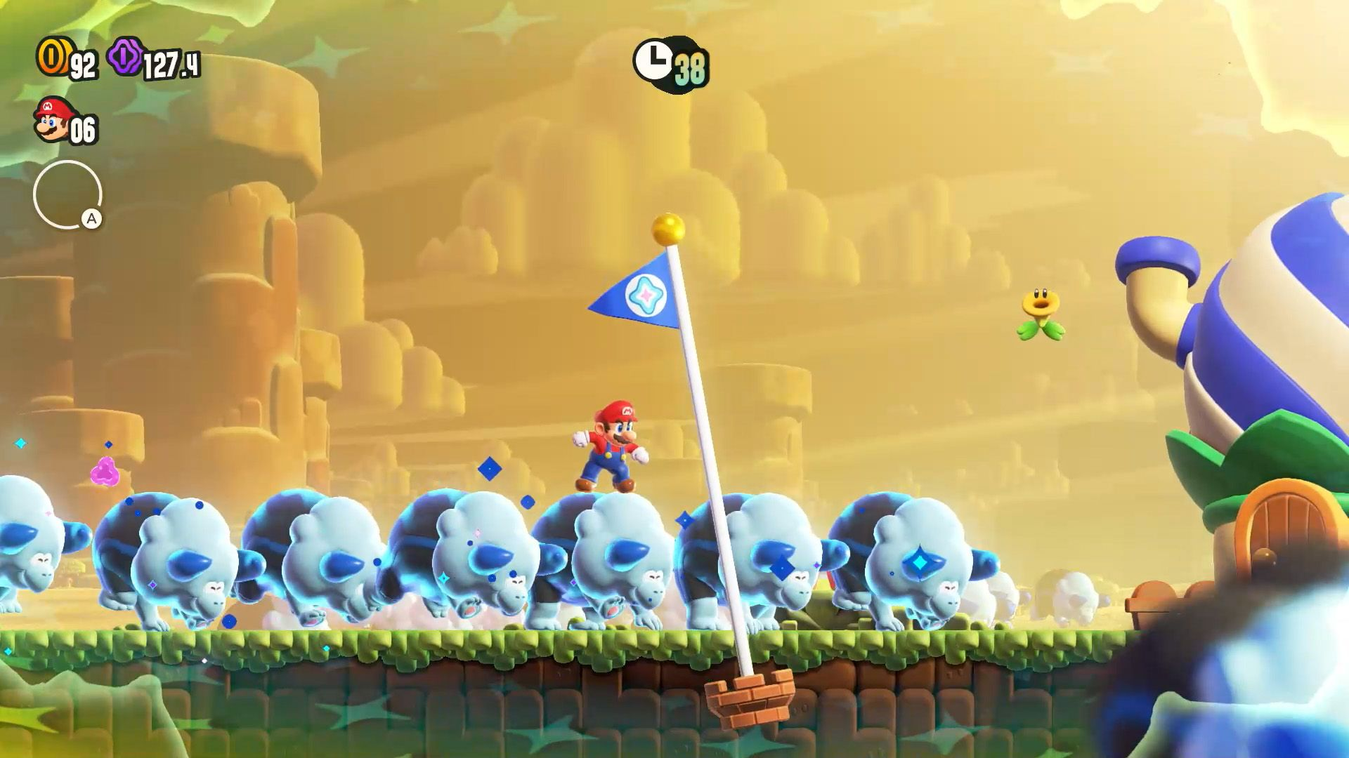
Gameplay
Describes the experience of play (what players do) in the game and defines the connection between a game and a player.
“The structures of player interaction with the game system and with other players in the game.”
Mario Wonders:
2D platformer in an imaginary setting, where the character called Mario, controlled by a player, fights monsters and tries to save Princess Peach.
*Image courtesy of Nintendo Co. Ltd.

Slide 6

QQ:
What’s your favourite game?

Slide 7
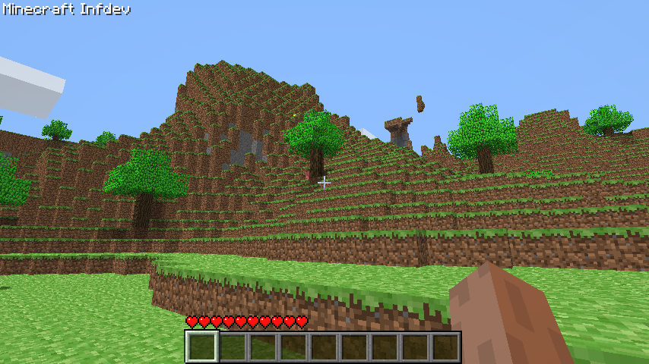
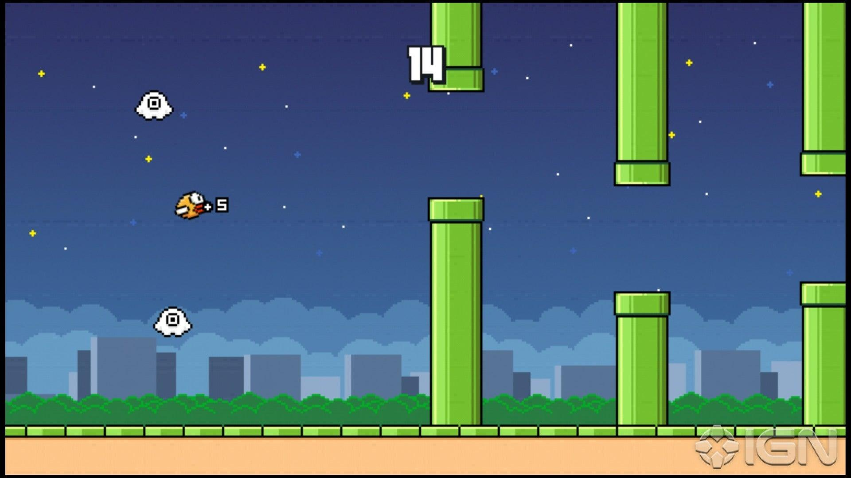
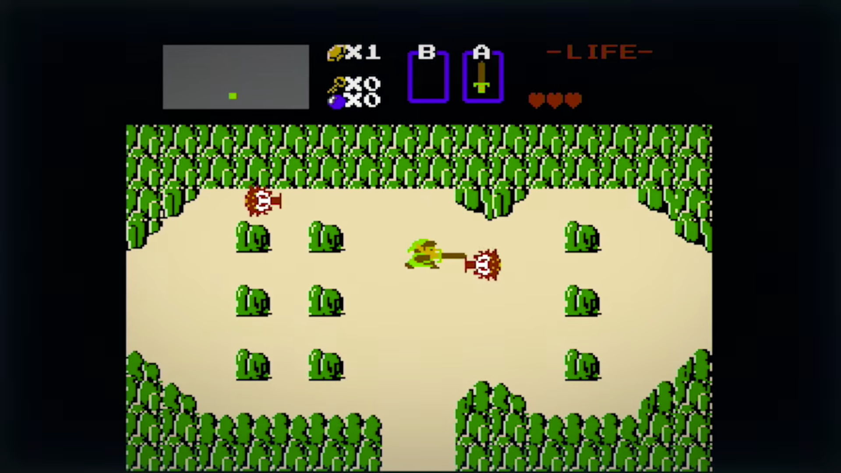
Mechanics
The rules, actions, and interactions defined in a game.
Minecraft:
Player can destroy one world block by clicking on it.
Monsters spawn at night.
Flappy Bird:
Tubes collide.
Game scrolls from one side.
The Legend of Zelda:
Character moves to another dungeon by stepping over the edge of the screen.
Character can hit monsters.
Character takes limited amount of damage.
Analogy: Mechanics are like grammar rules for a language.
*Images courtesy of Mojang Studios, DotGears Company Limited,
Nintendo Co. Ltd. (top to bottom)

Slide 8
QQ:
What are the game mechanics your favourite game implements?

Slide 9
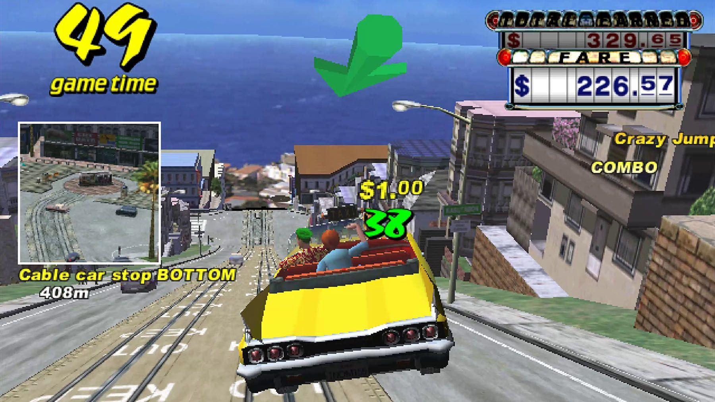
End goal
QQ: Why does a goal matter?
Crazy Taxi:
pick up and deliver as many passengers as possible
*Image courtesy of Sega Corporation

Slide 10
Technical aspects of developing games

Slide 11
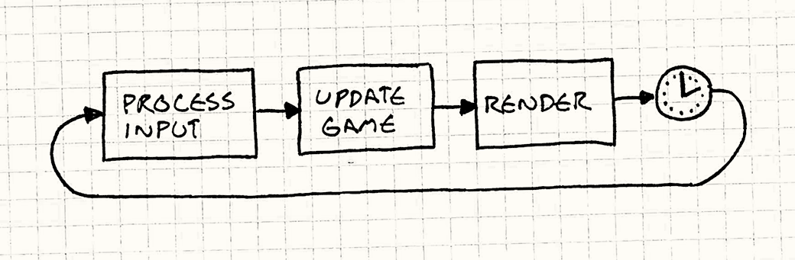
Game Loop
At the heart of every game is an infinite loop, often called the game loop. Each cycle of this loop is known as a frame.
During each frame, the game engine performs three key steps:
Processes input/events – like keyboard, mouse, or touch input.
Updates the game state – such as character positions, scores, and collisions.
Renders the scene – draws the current state to the screen.
*Image courtesy of “Game Programming Patterns”
by Robert Nystrom

Slide 12

Practice

Slide 13
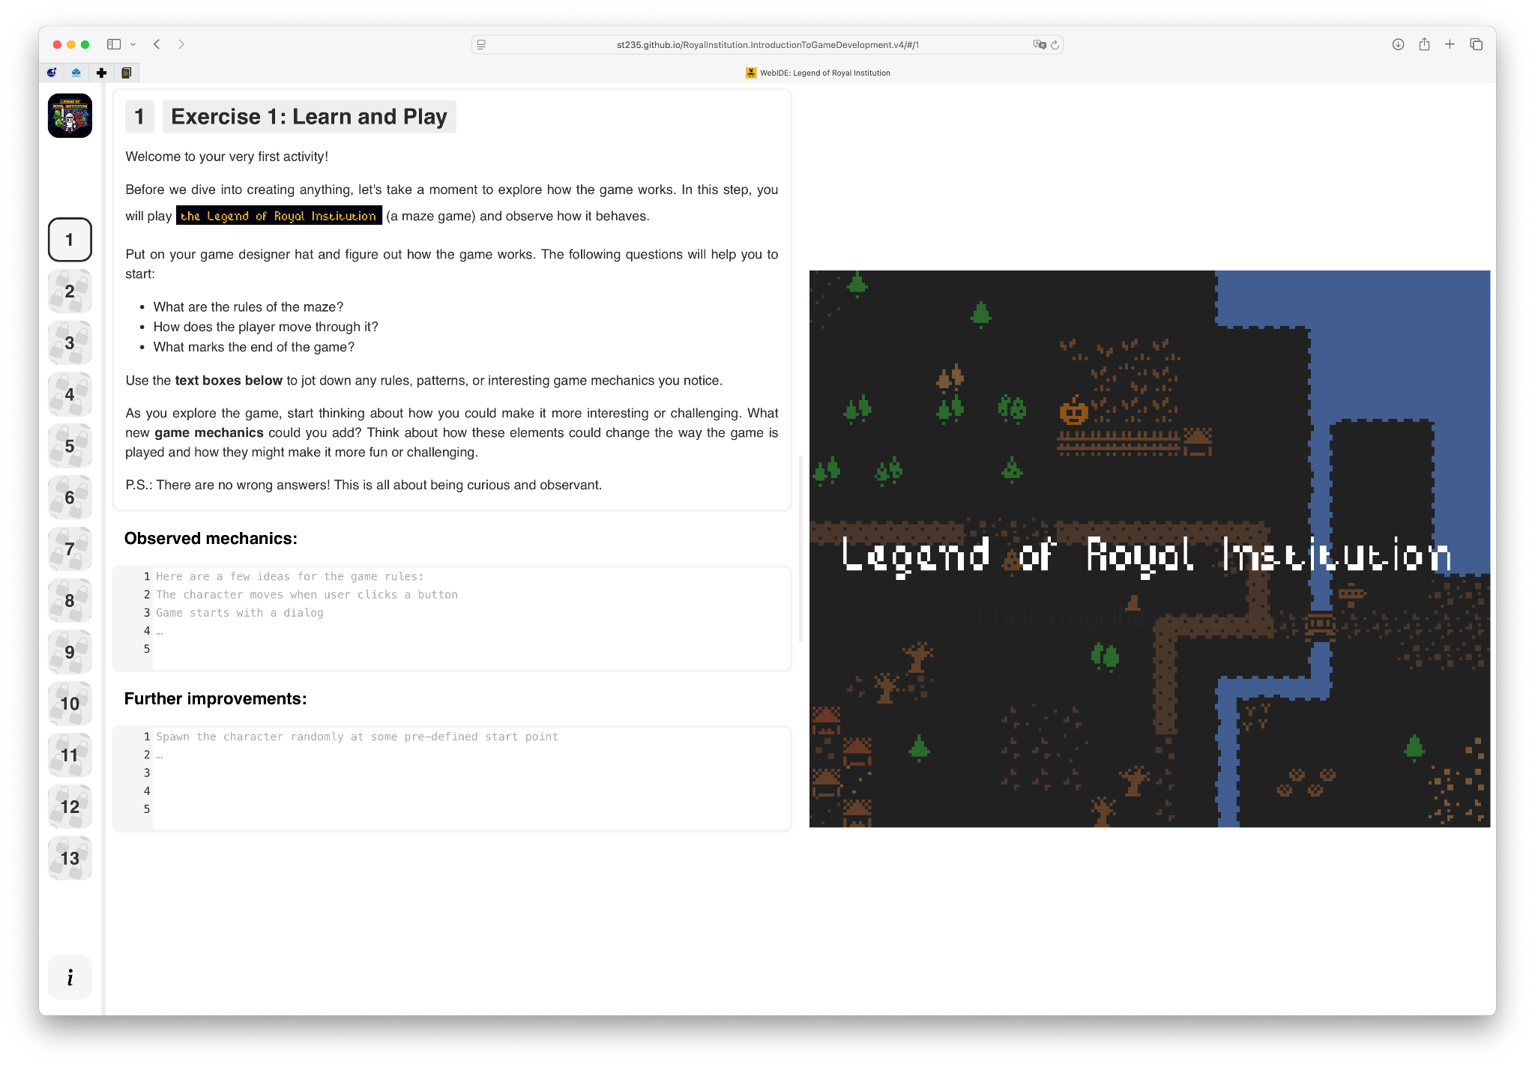
Running activities
🔗 tinyurl.com/yzfvbyds

Slide 14
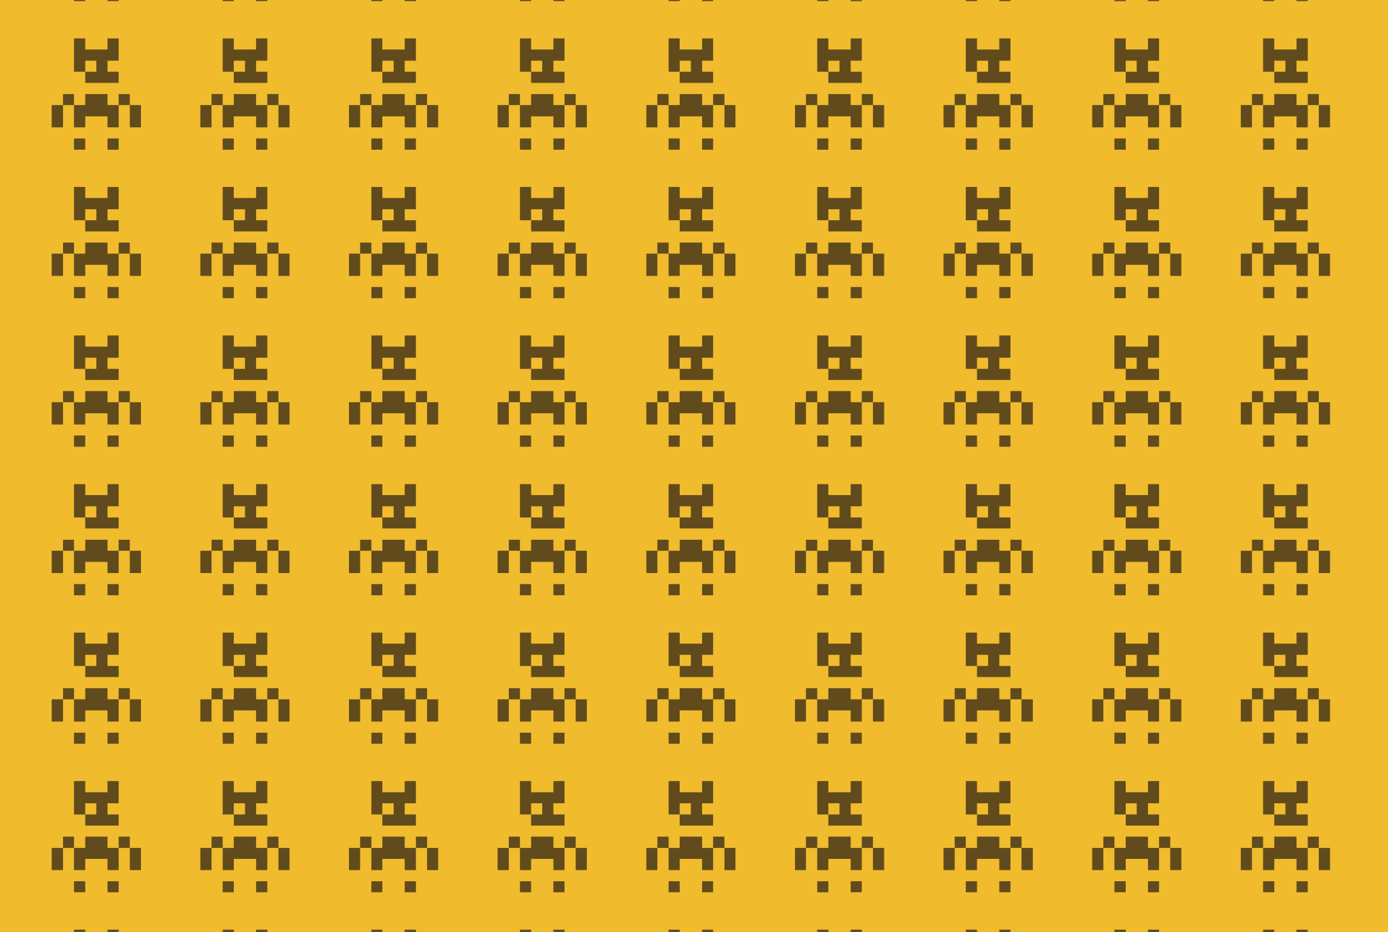
Learn & Play

Slide 15


Data-Driven Game Development
github.com/soulsmods/Paramdex
In a config-driven design, the core game engine is relatively generic, while the rules, content, and behaviors are defined in external data/config files.
Dark Souls (and the other souls-like games):
extremely config/data-driven under the hood.
*Image courtesy of FromSoftware

Slide 16
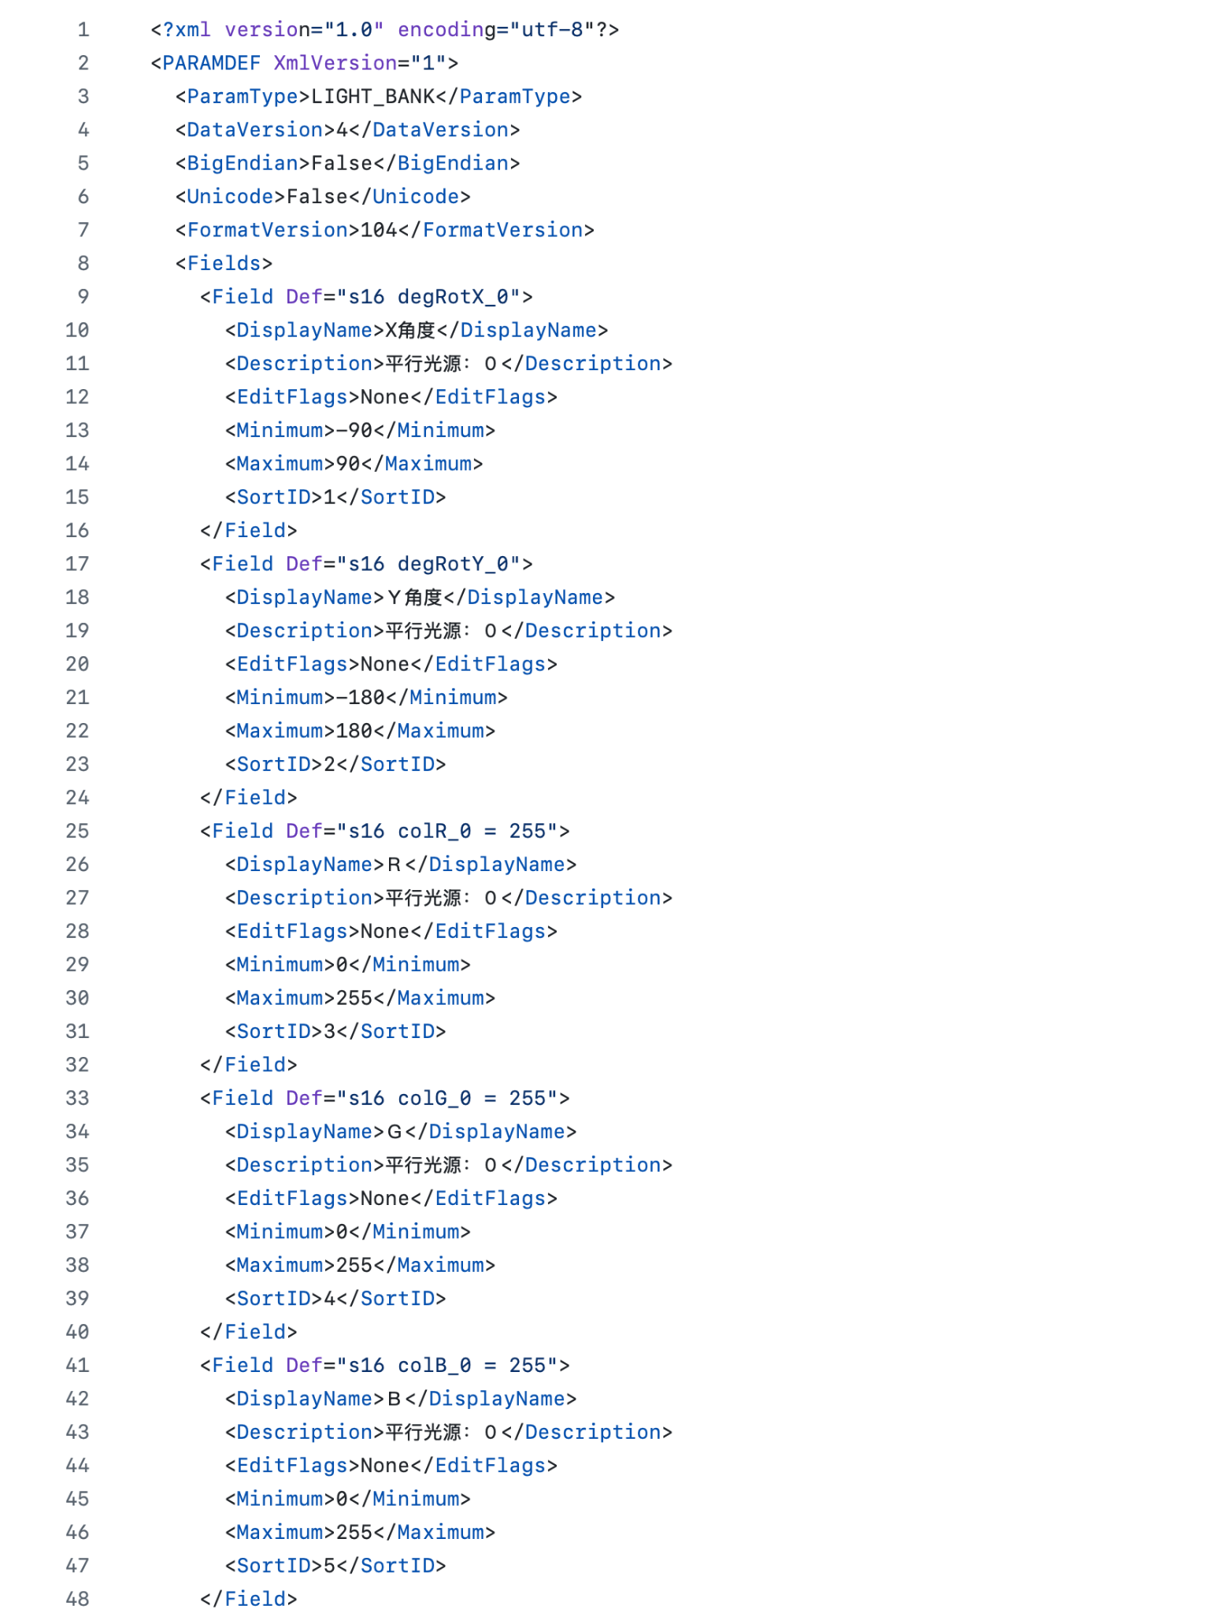
Dark Souls 1: Config Example

Slide 17
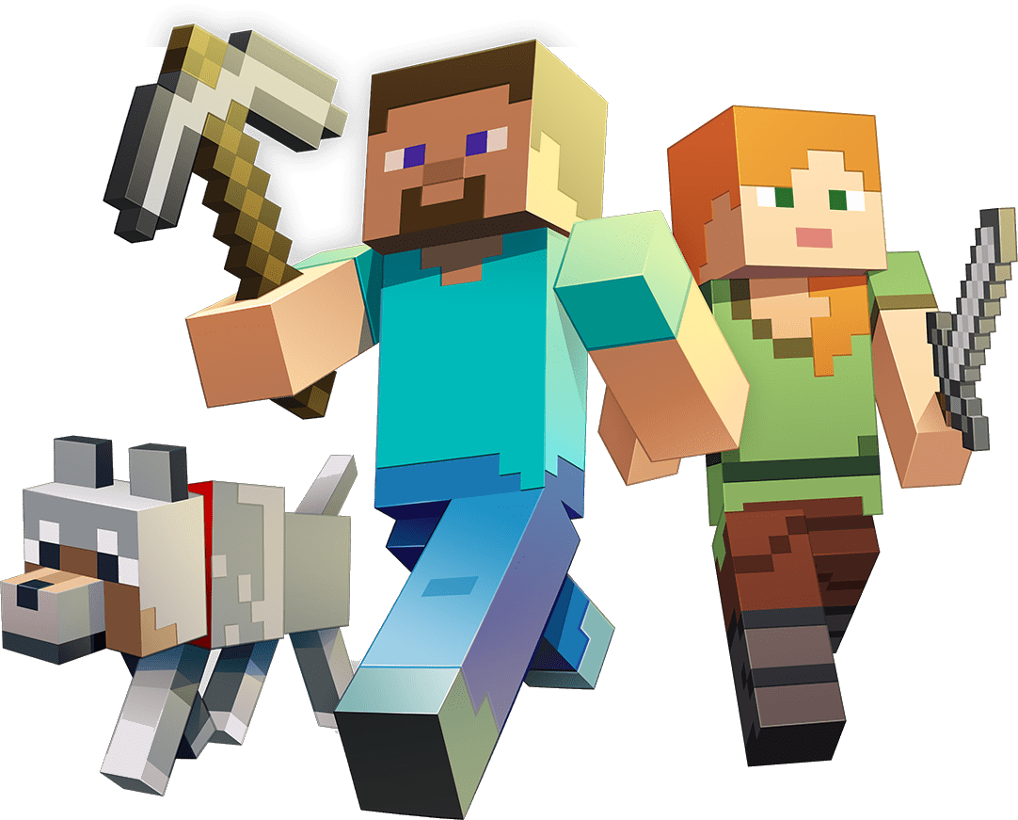
Data-Driven Game Development
Minecraft’s gameplay is also not just defined by code in the engine: a lot of it lives in external JSON files, configs, and resource packs.
Data Packs
Introduced in Minecraft 1.13+, data packs define game mechanics, loot, recipes, and structures through JSON configs, such as, recipes, loot tables, or structures.
*Image courtesy of Mojang Studios

Slide 18
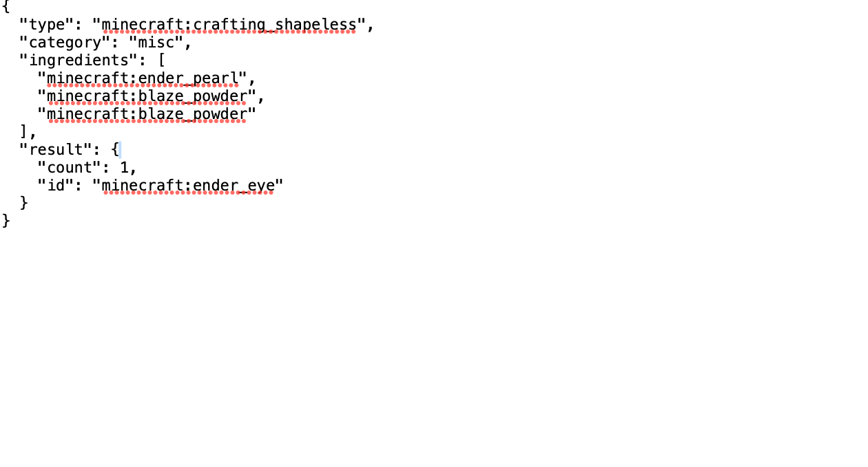
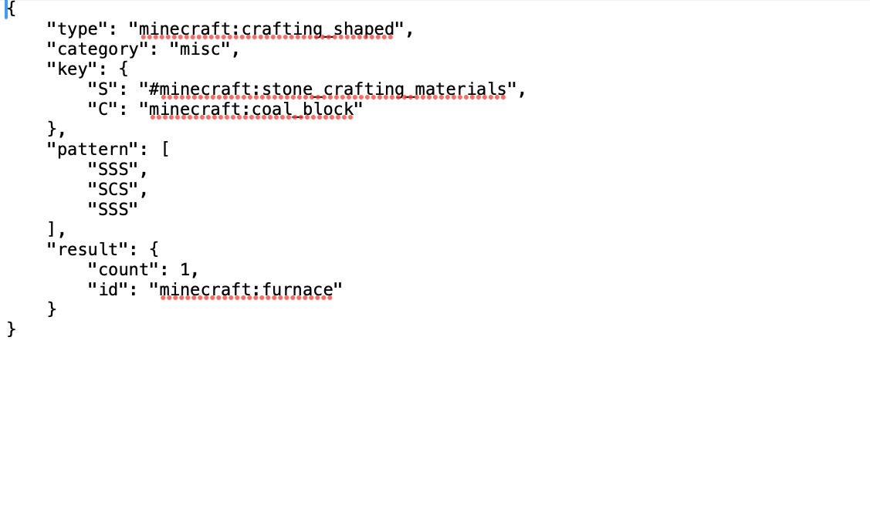
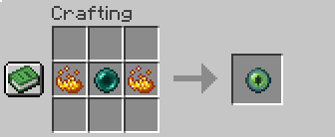
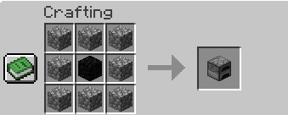
Minecraft: Config Example

Slide 19

Data-Driven Game Development
The Legend of Royal Institution also relies on config files.
The configs define almost everything:
Character appearance
Finish (flag) position appearance
Layout of the level
and many more…

Slide 20
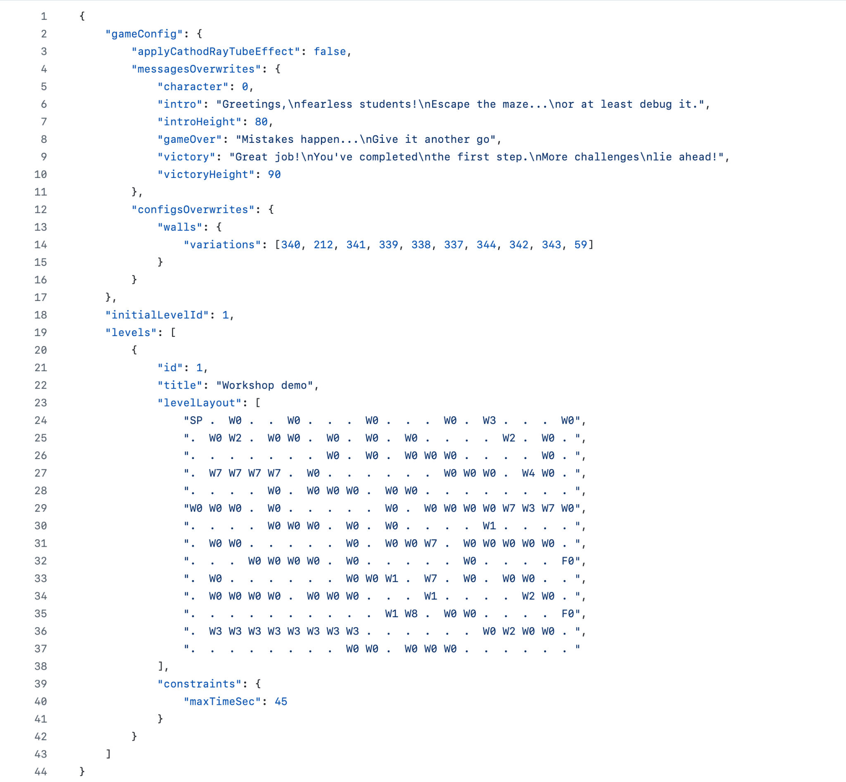
Legend of Royal Institution: Config Example

Slide 21
Time to tune configs

Slide 22

1.Level Layout

Slide 23
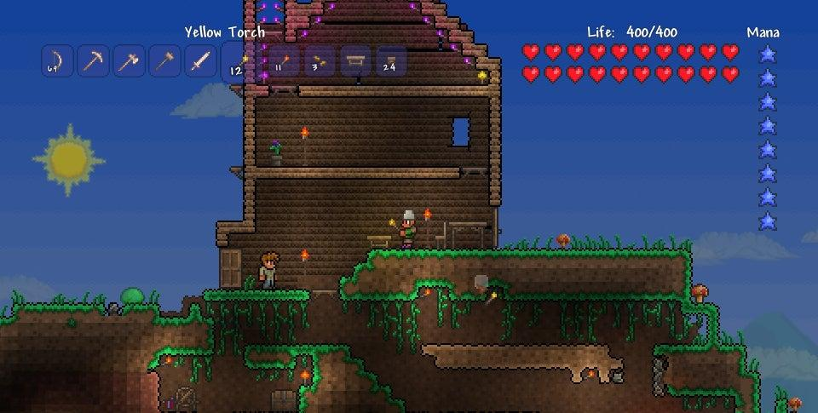
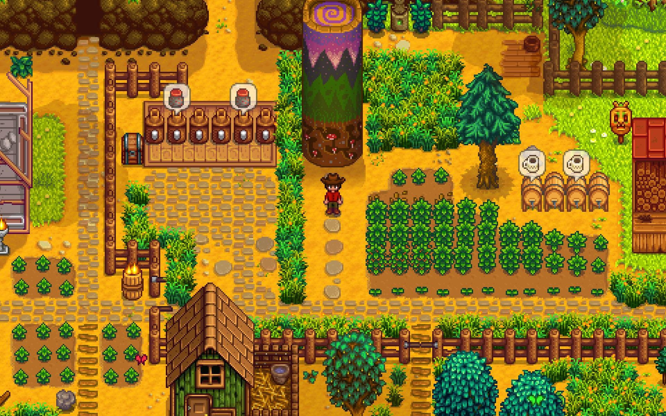
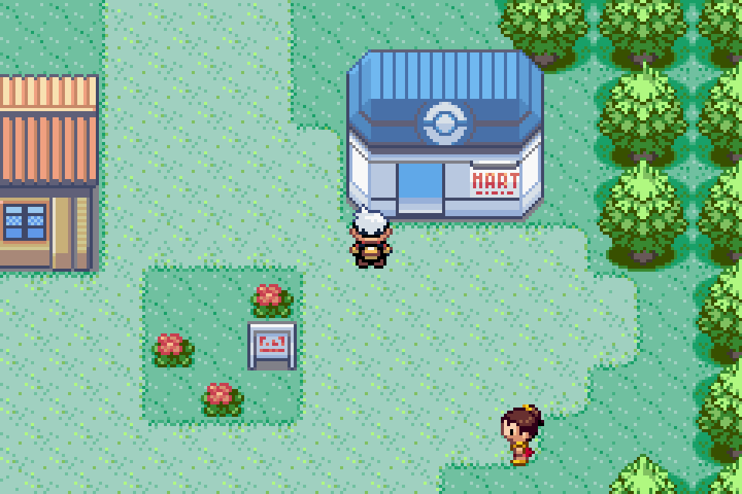
Tilemap
Tile is a small, reusable graphic (usually square or rectangular) that represents a piece of a larger map, environment, or grid in a game.
A tilemap is a grid-based system (usually, 2D) that arranges tiles to form game levels, environments, or maps.
There are a lot of games using tilemaps: Terraria, Stardew Valley, and Pokemon Ruby.
*Images courtesy of 505 Games S.p.A., ConcernedApe,
Nintendo Co. Ltd. (top to bottom)

Slide 24

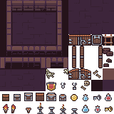
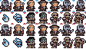
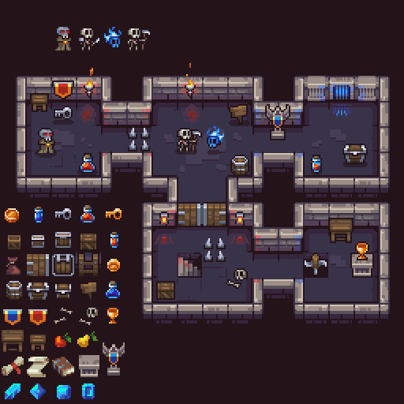
Tiles organisation: tilesets
pixel-poem.itch.io/dungeon-assetpuck
To keep things efficient, games use a tileset (a collection of all available tile graphics).
The tilemap stores only the index or ID of which tile appears in each grid cell.
This allows developers to build large environments without duplicating image data.
Often, tilemaps are arranged in layers: a background layer for terrain, a collision layer for walls and obstacles, and a decorative layer for details.
Tileset
Level example

Slide 25

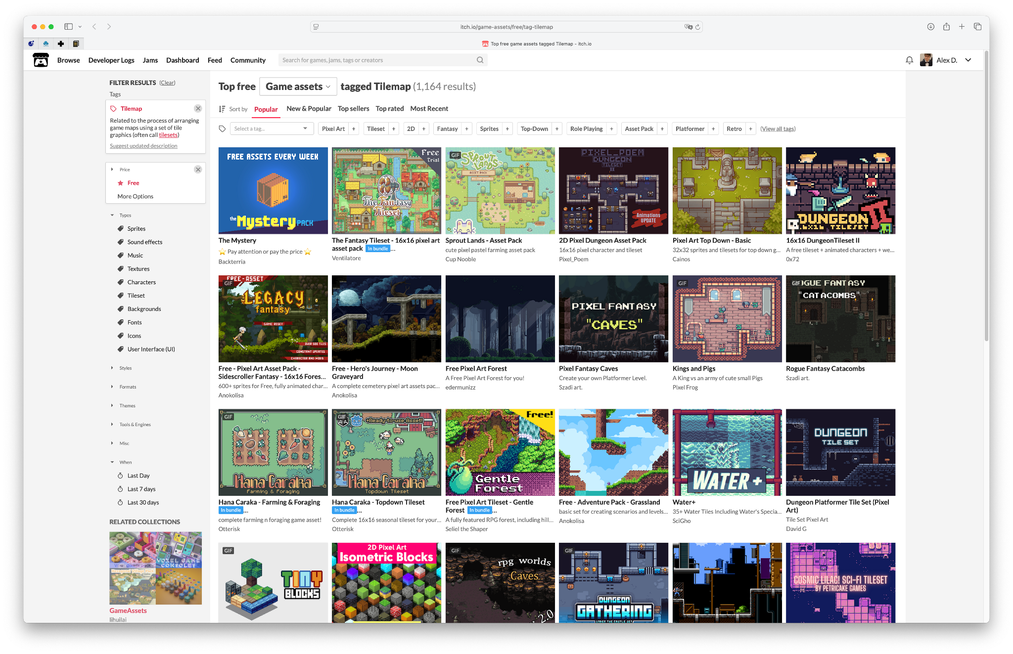
Getting assets and publishing indie projects
🔗 itch.io

Slide 26
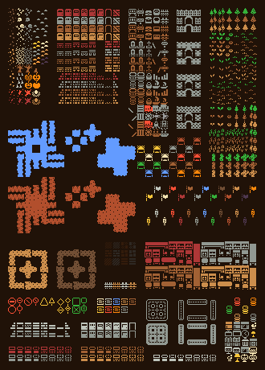
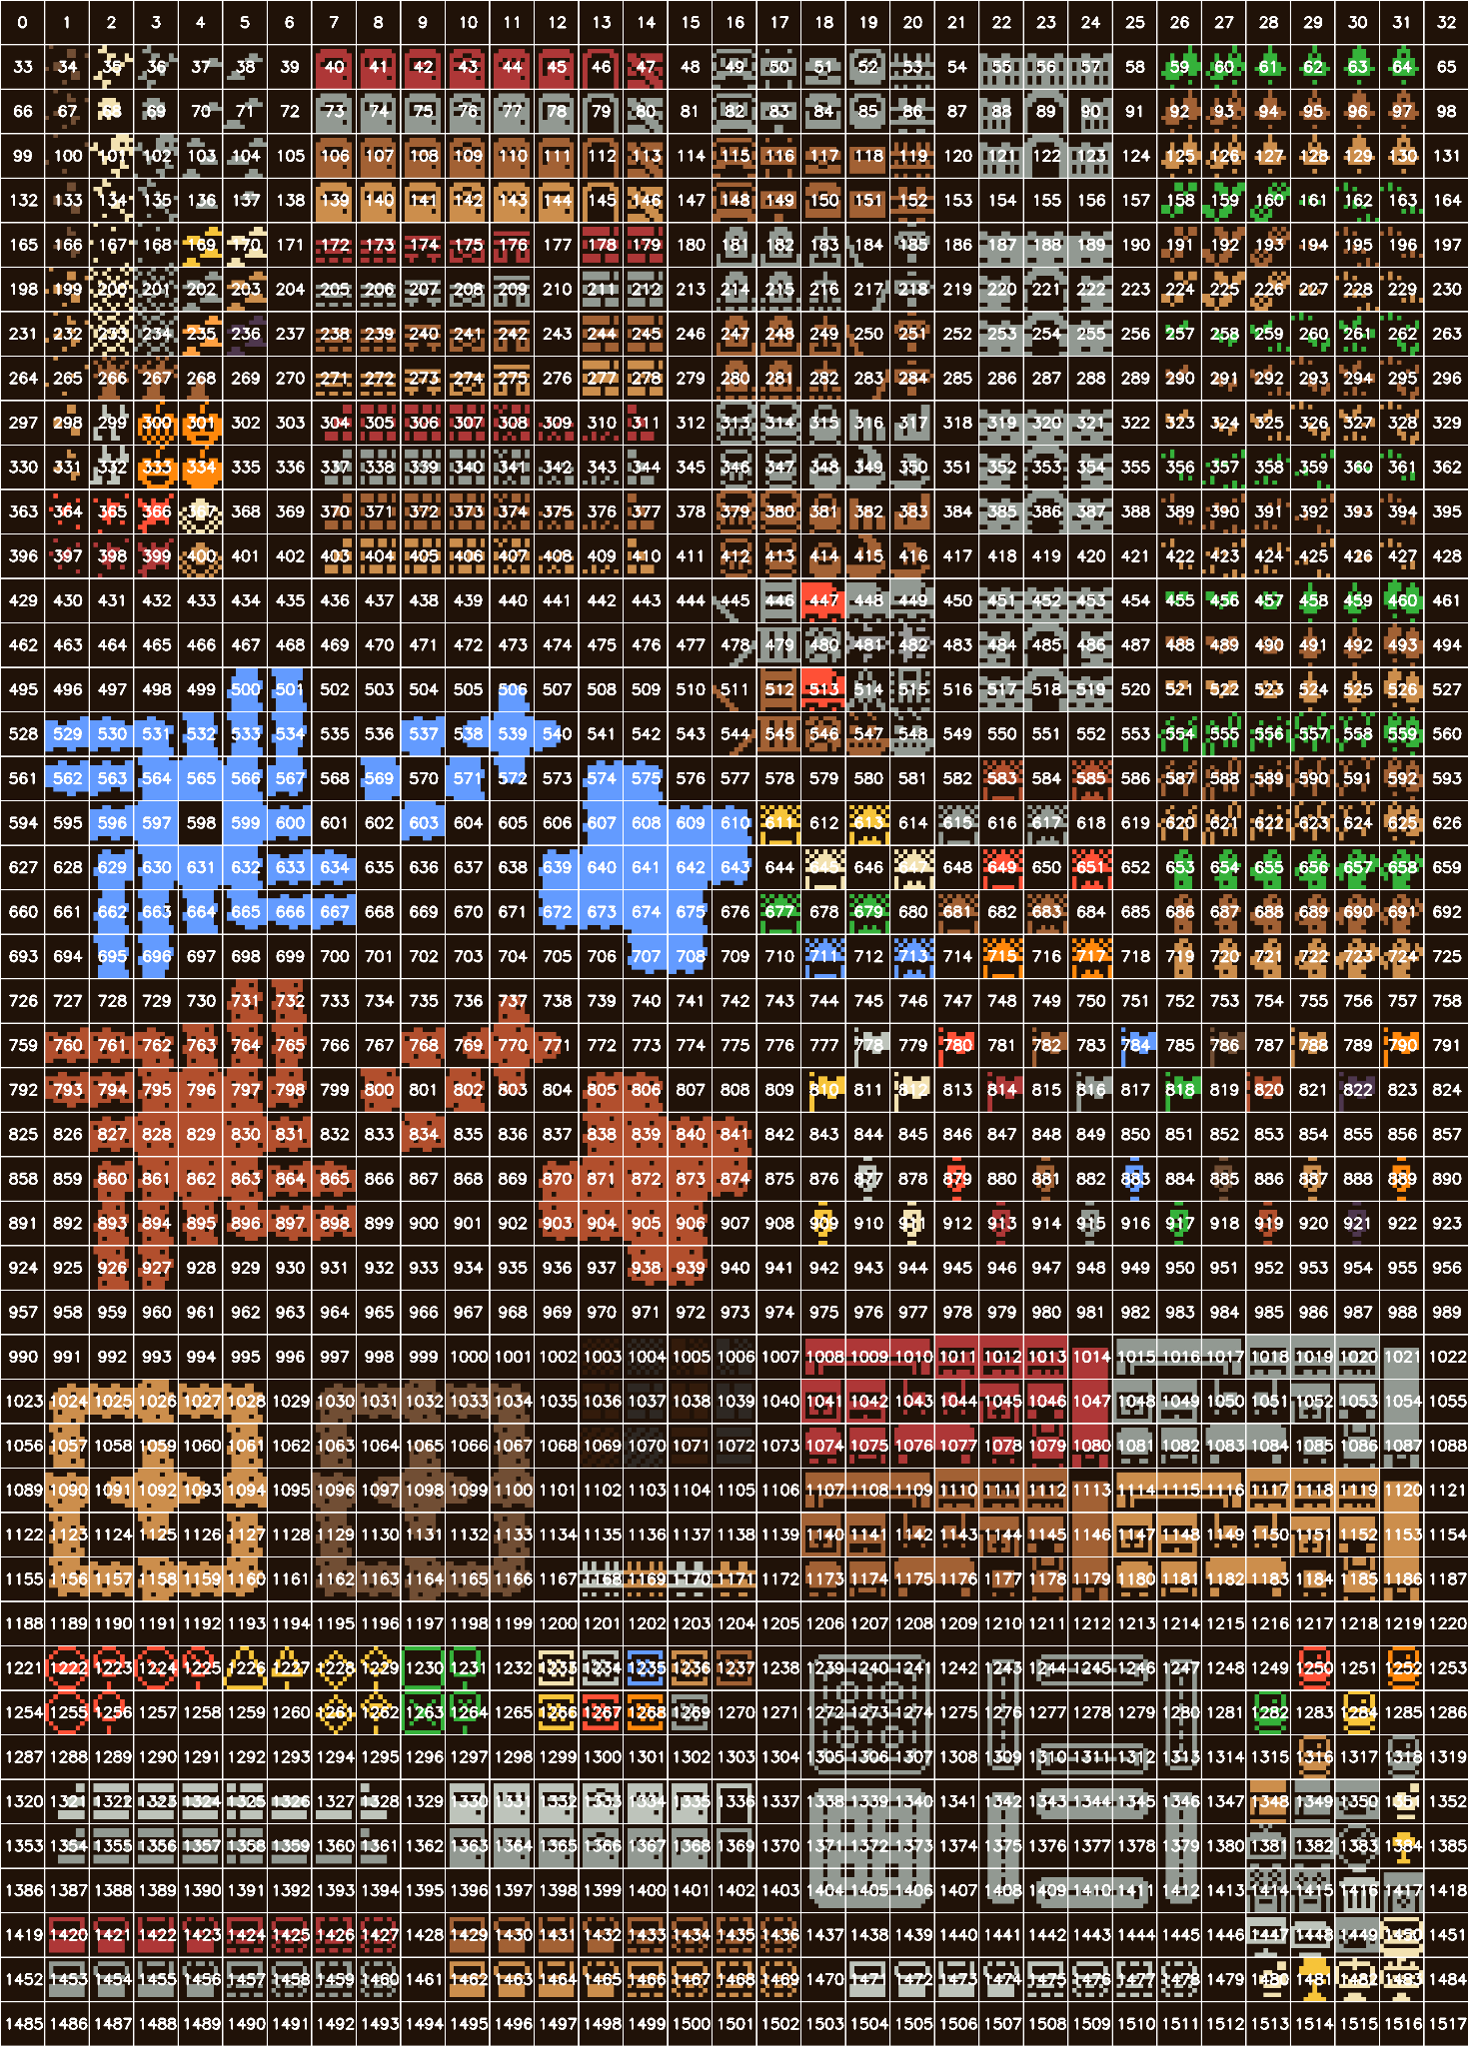
Legend of Royal Institution: tileset
v3x3d.itch.io/bountiful-bits
Our game also uses tilesets from itch.io with non-restrictive license.

Slide 27






2.Walls Appearance

Slide 28
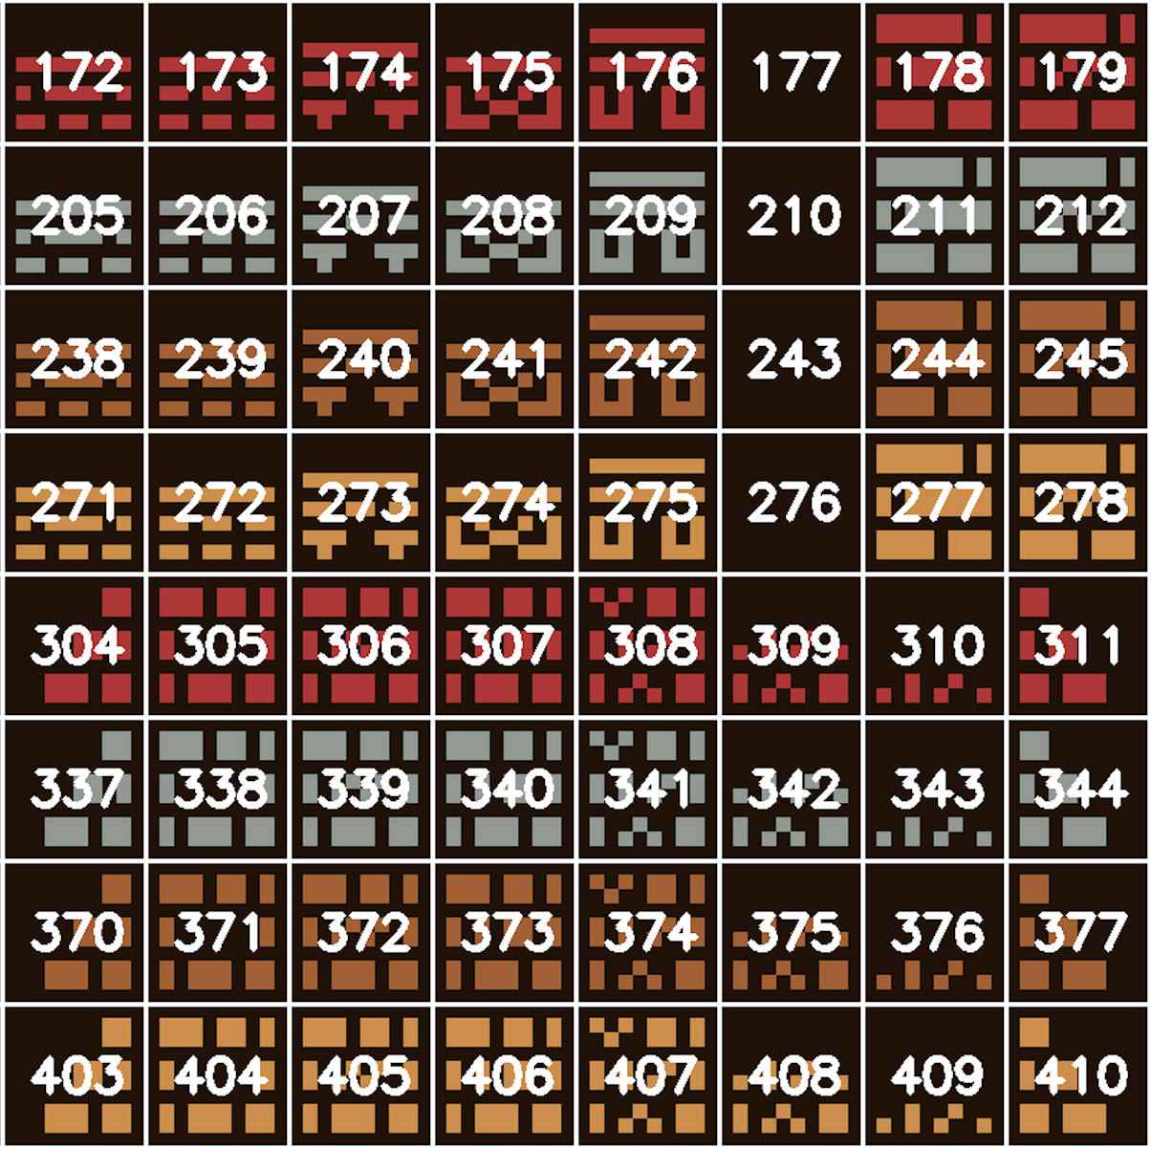
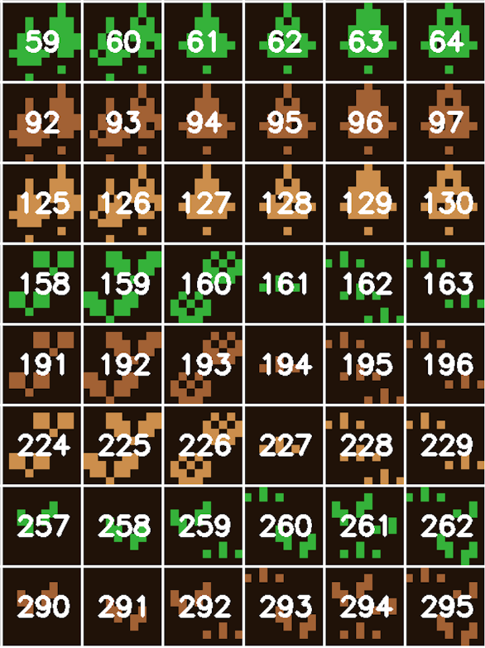
Walls tileset

Slide 29



3.Coins

Slide 30
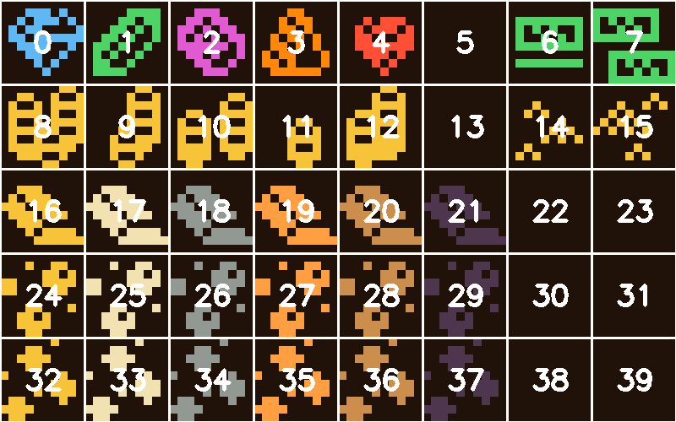
Coins tileset

Slide 31

4.Doors

Slide 32
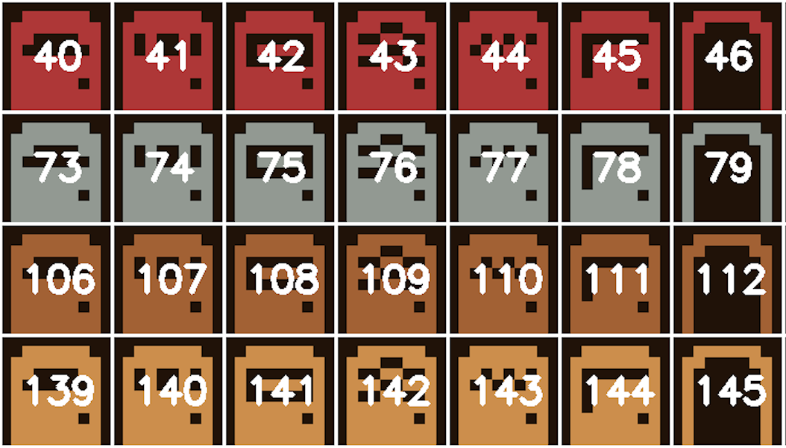
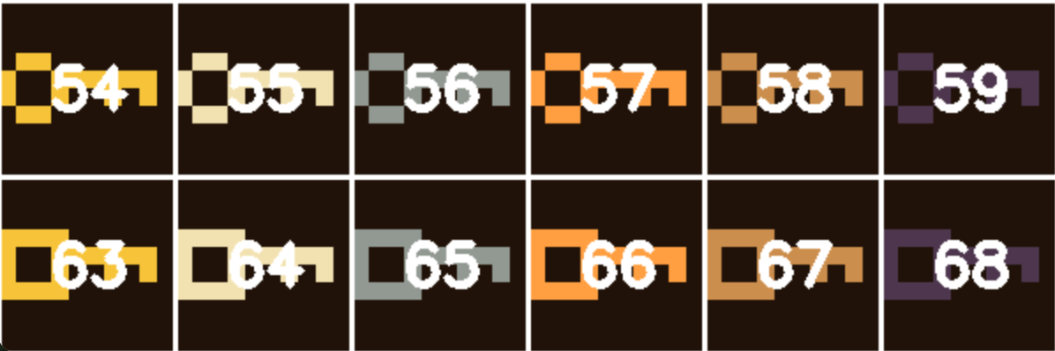
Doors&Keys tilesets

Slide 33

5.Monsters AI

Slide 34
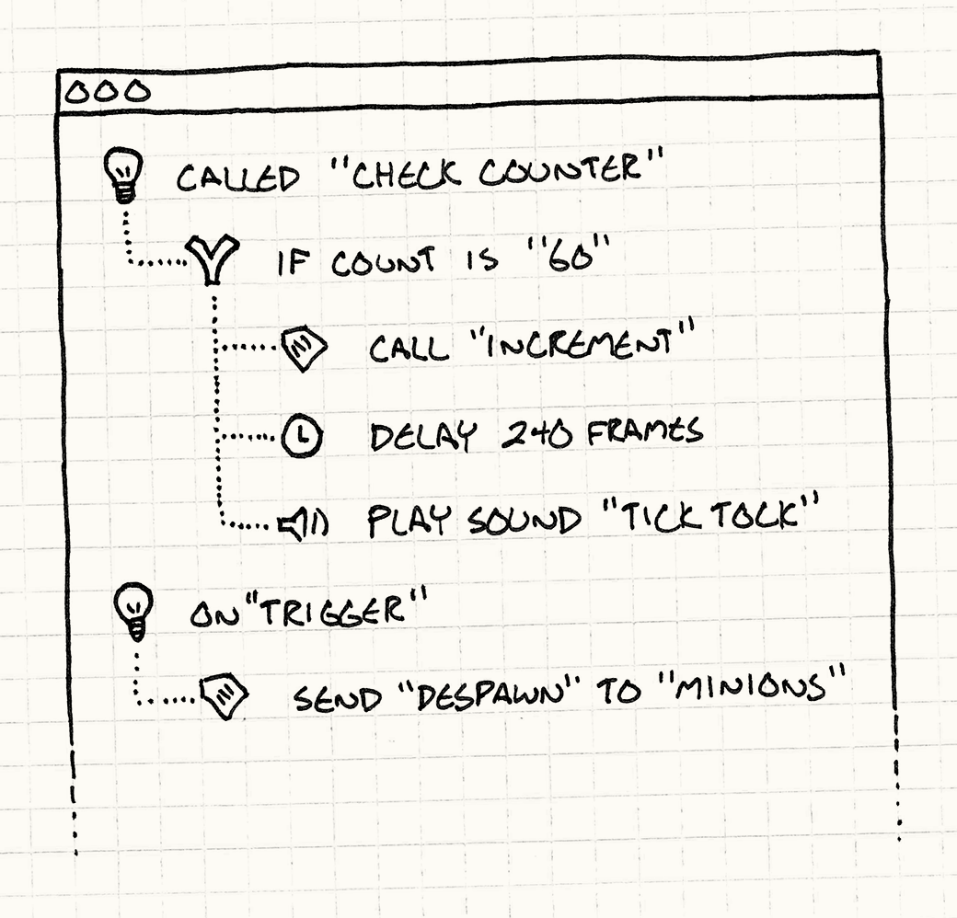
Scripting Language: Bytecode
Game can roughly be divided into a core/engine code and a gameplay code.
Engine:
very generic
extremely complicated
rendering your game on a specific platform
Gameplay:
game-specific behavior
requires constant iteration
That’s why game engines usually abstract gameplay logic into something more lightweight.
*Images are courtesy of “Game Programming Patterns” by Robert Nystrom https://gameprogrammingpatterns.com/bytecode.html
Notes:
Players demand novel, fun, and well-balanced games. This process requires constant iteration: that’s why every gameplay tweak should not bug low-level engine code and be blocked on recompiling a big chunk of generic engine algorithms (which can take hours!).

Slide 35
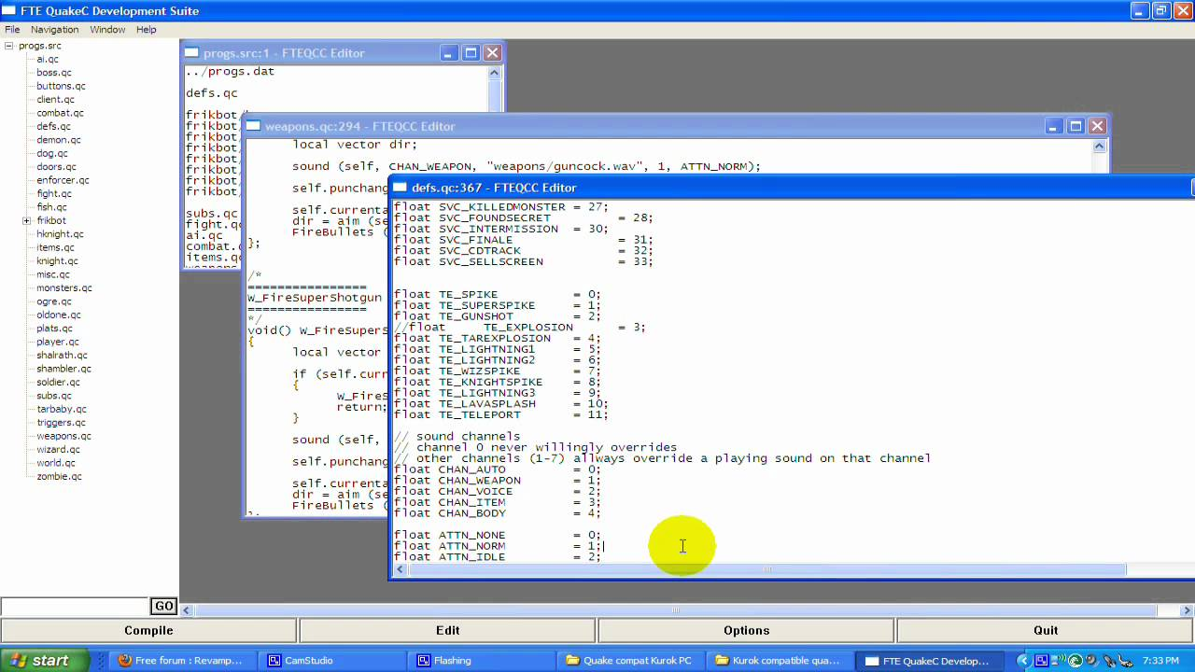
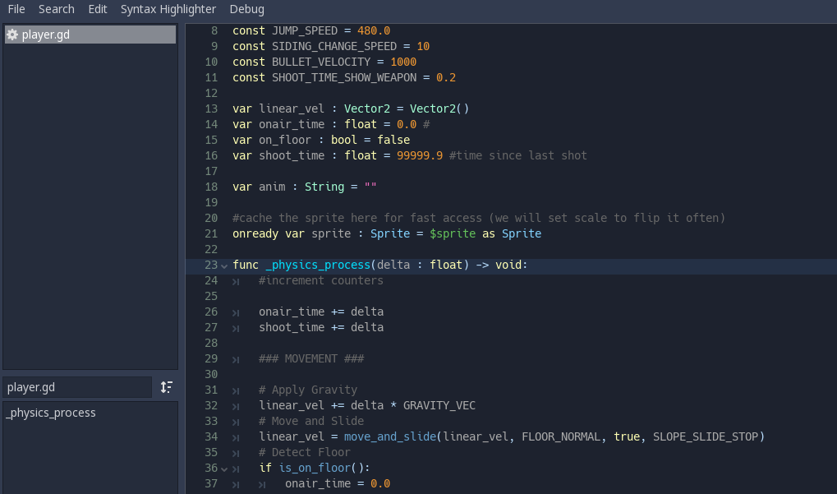
Scripting Language: Custom Language
The scripting languages can be as complicated as a full-scale language within the game engine.
QuakeC
UnrealScript
GDScript
Naughty Dog’s DC Language

Slide 36
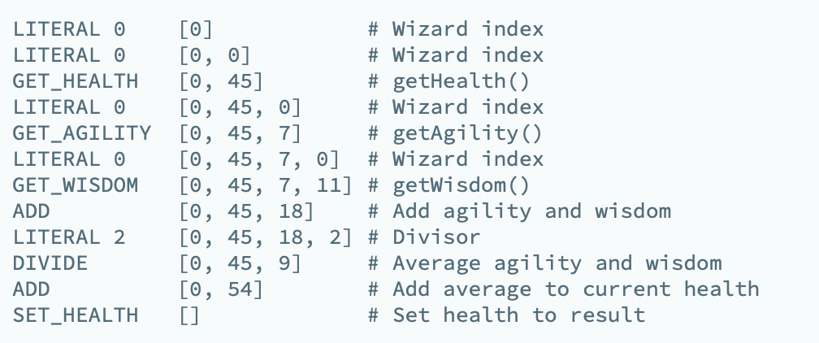

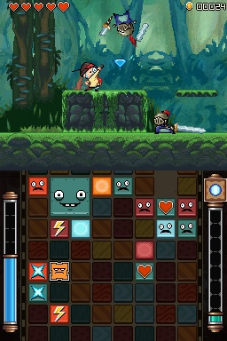
Scripting Language: Custom Instruction Set
Henry Hatsworth in the Puzzling Adventure for Nintendo DS used this approach.
Alternatively, they can be defined as a custom limited size instructions set. For example, a spells list for a magic game.
*Image is a courtesy of Electronic Arts Inc.

Slide 37

Scripting Language: Custom Instruction Set
The Legend of Royal Institution uses a small markup language for monsters movement system defined by a set of rules.
A monster’s movement is defined by 2 parameters:
the update time (in milliseconds): how often the monster will move to the next position.
a movement list: a set of instructions defining the specific path/trajectory of the monster.

Slide 38

Legend of Royal Institution: Movement System
Every move command is either:
A direction;
A direction followed by colon and a repeat counter.
Allowed directions are: left, right, up, down.
A few tips:
Every path should start and end at the exact same point.
Monsters can move through the walls.
Path is: right down:2 left up left up right

Slide 39
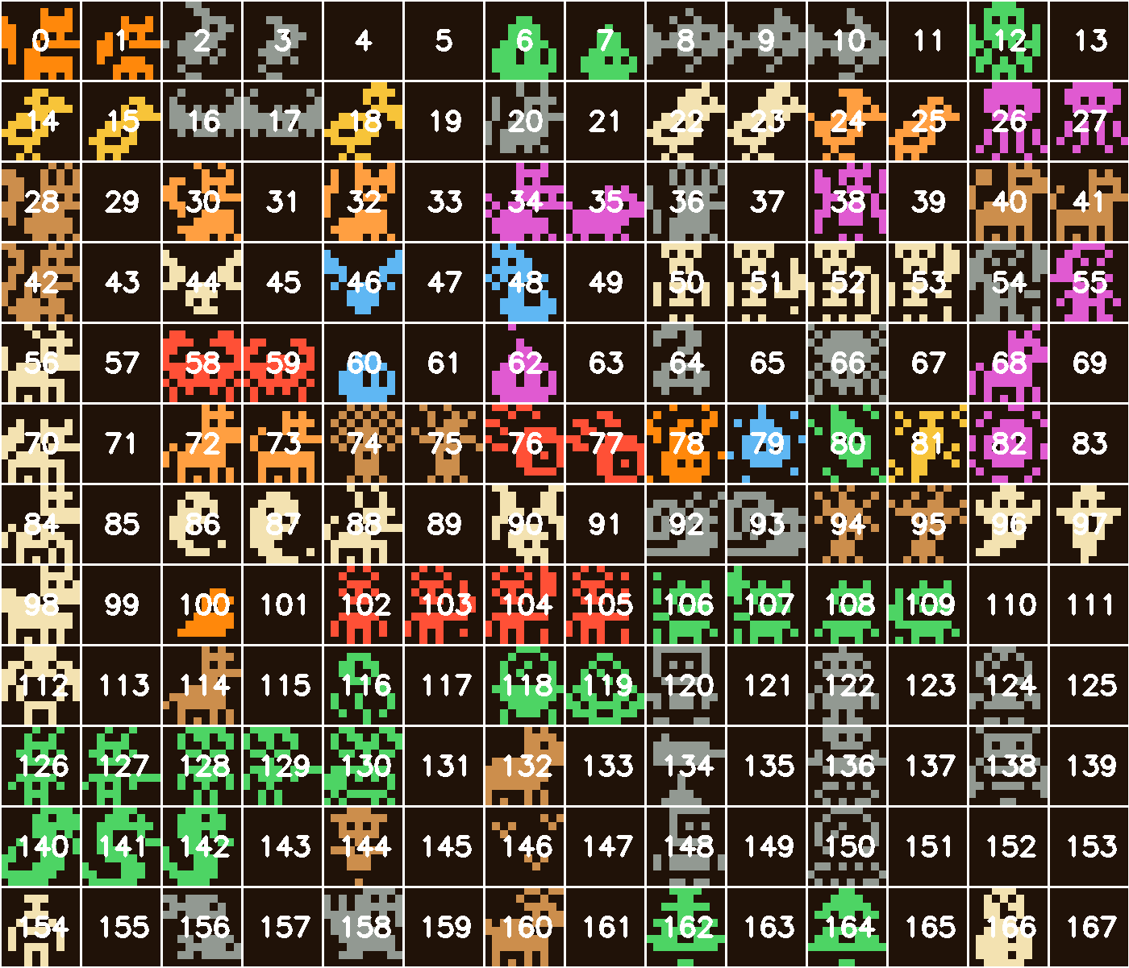
Creatures tileset

Slide 40

6.Garnitures

Slide 41
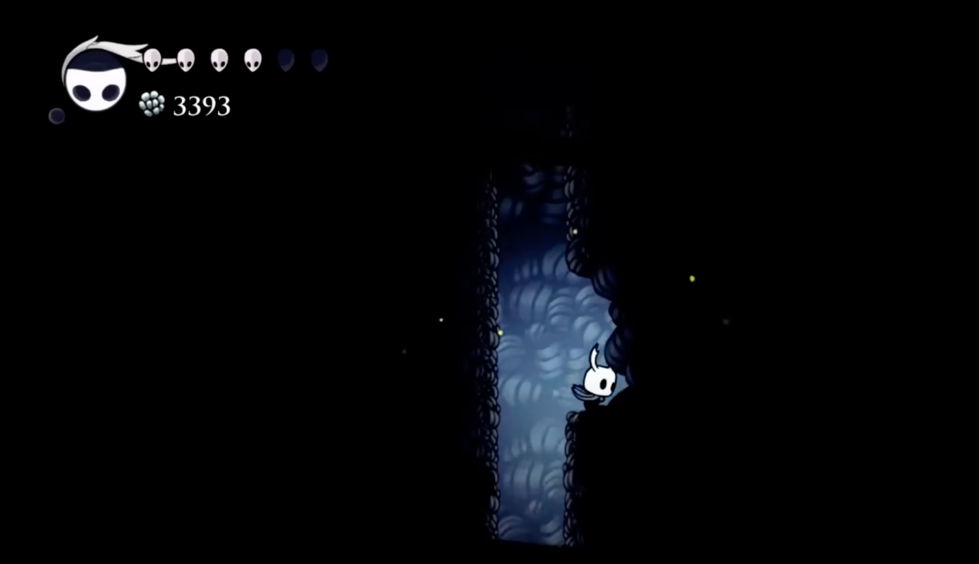
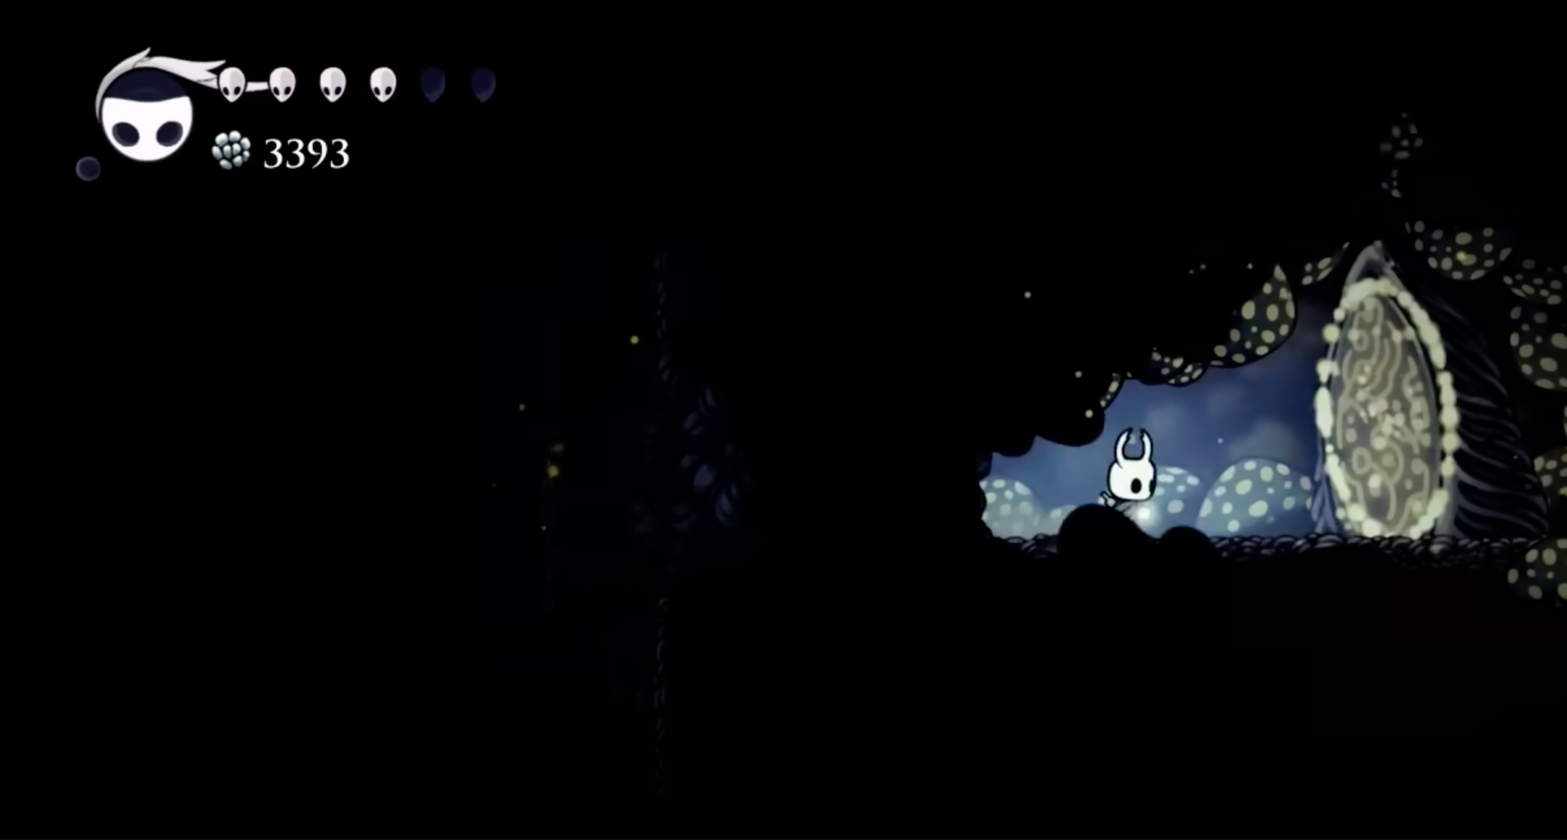
Easter Eggs: Hidden Locations
Easter eggs are secret features deliberately placed by developers to surprise and reward curious players.
Examples:
hidden rooms
references to other games
humorous messages
powerful items (sometimes imbalanced!)
Encourage exploration and create memorable “aha!” moments.
*Image courtesy of Team Cherry
Notes:
Easter eggs are secret features deliberately placed by developers to surprise and reward curious players.
They can take many forms, such as hidden rooms, references to other games, humorous messages, or powerful items tucked away off the main path. These secrets encourage exploration, add layers of mystery, and often strengthen a game’s community through shared discoveries. By blending seamlessly into the environment (sometimes requiring clever problem-solving or unconventional actions to access!) easter eggs enrich the player’s sense of immersion and create memorable “aha!” moments.

Slide 42
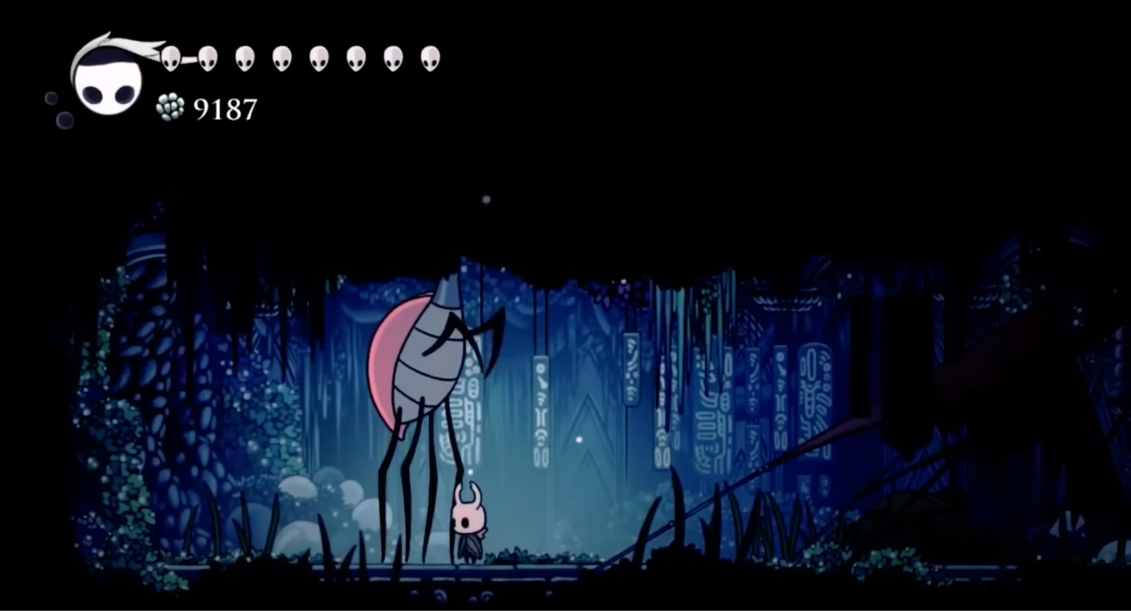
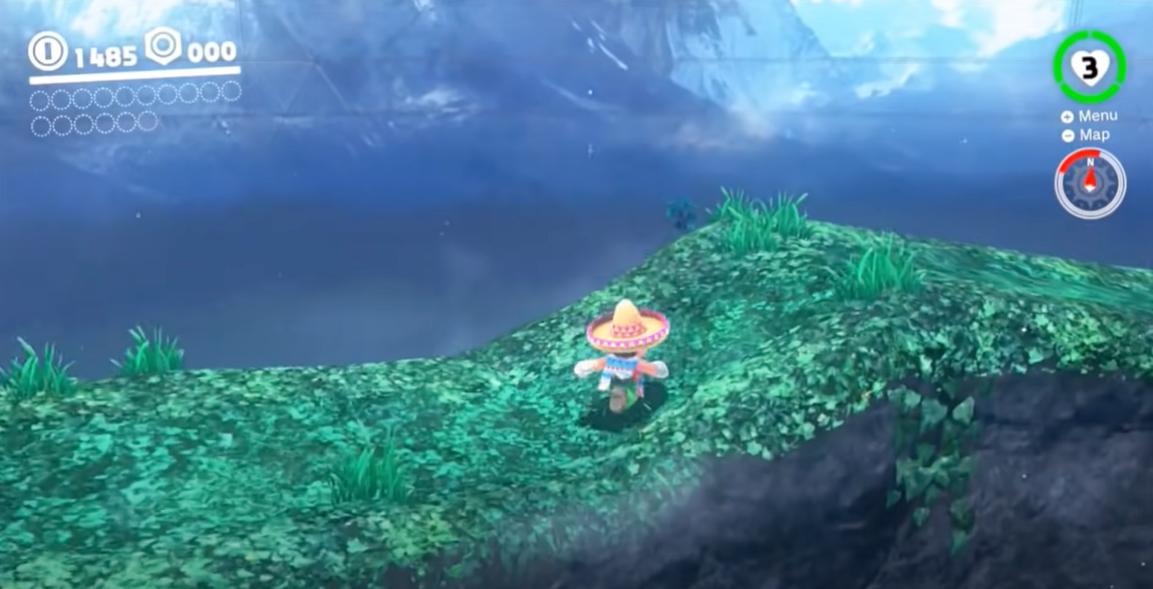
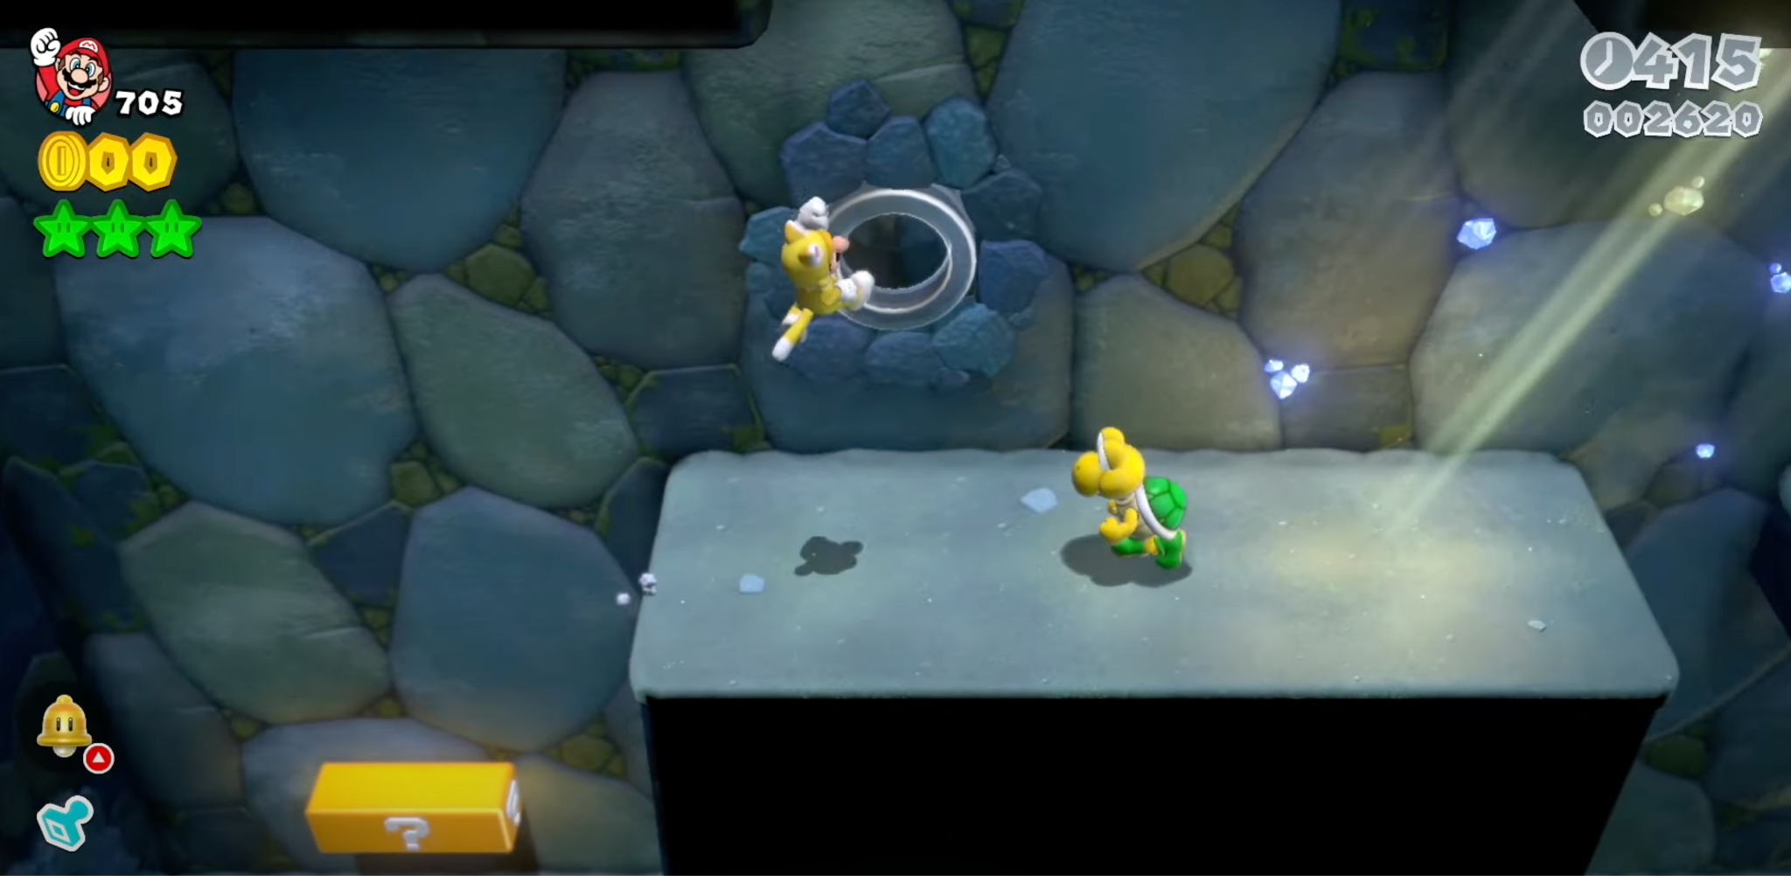
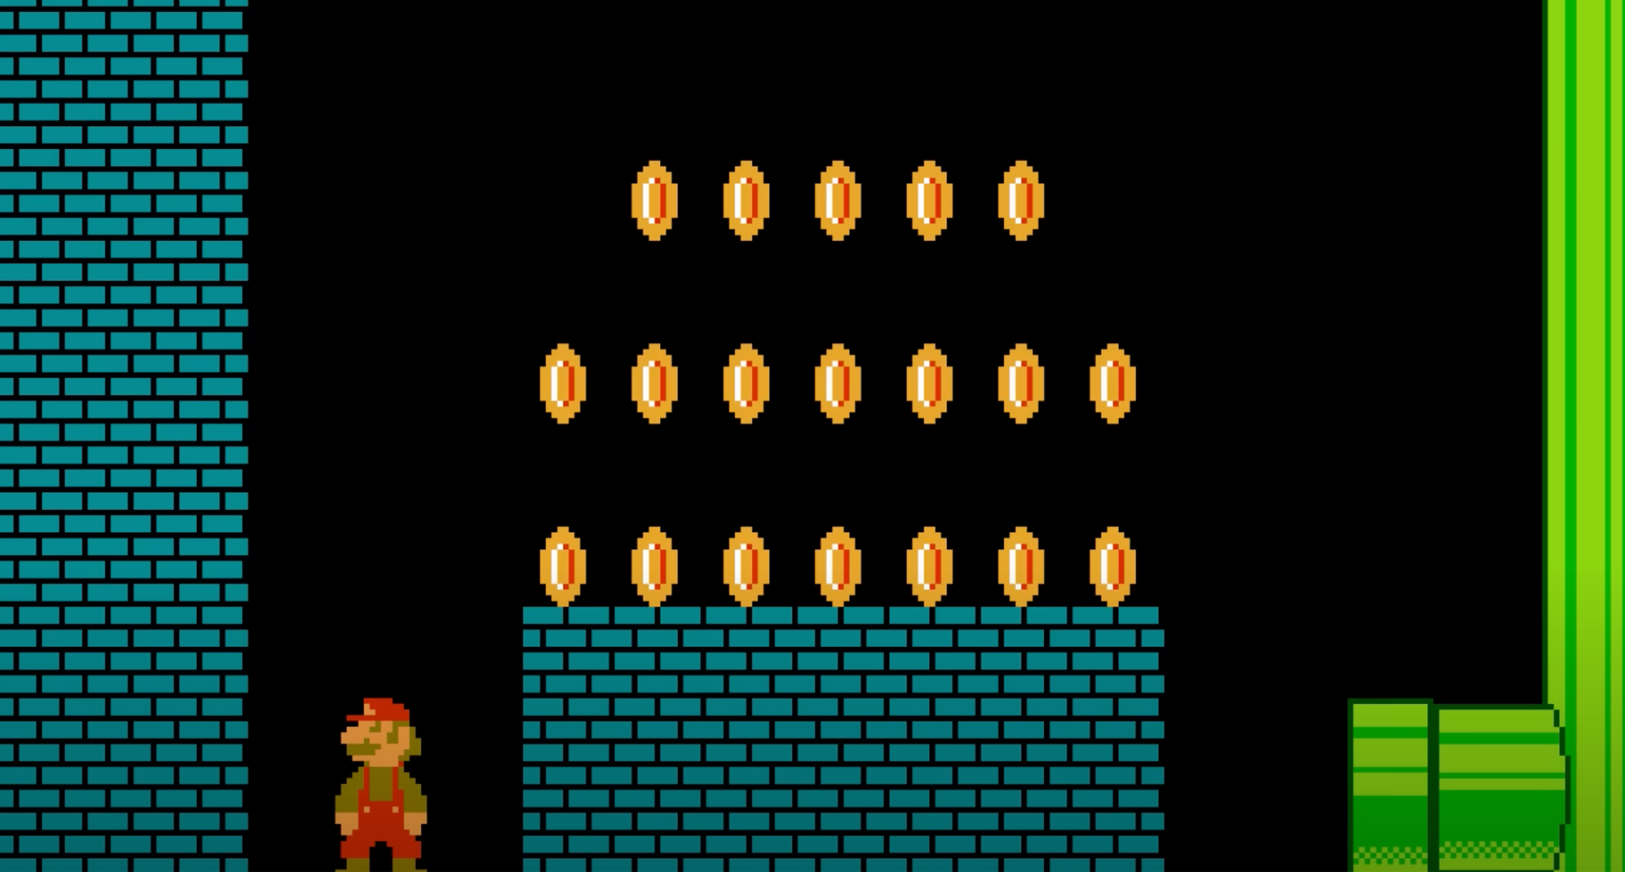

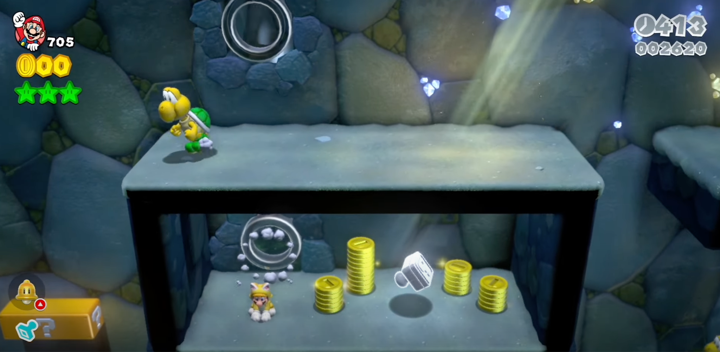
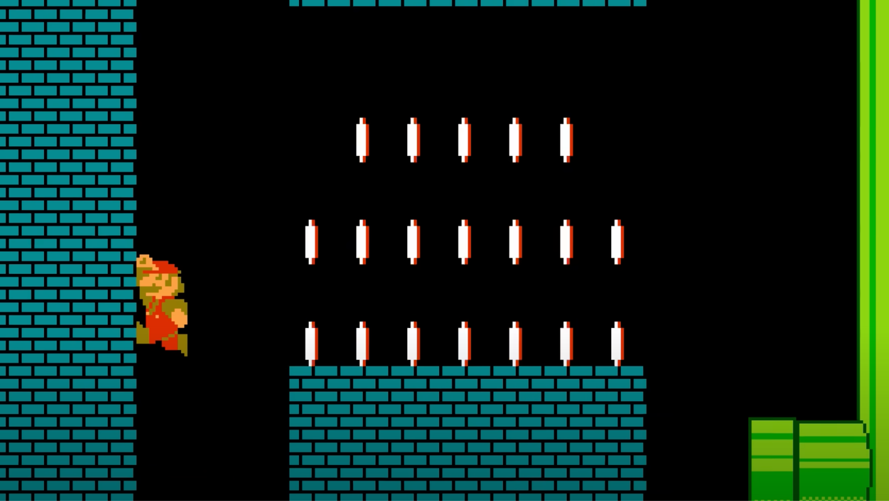
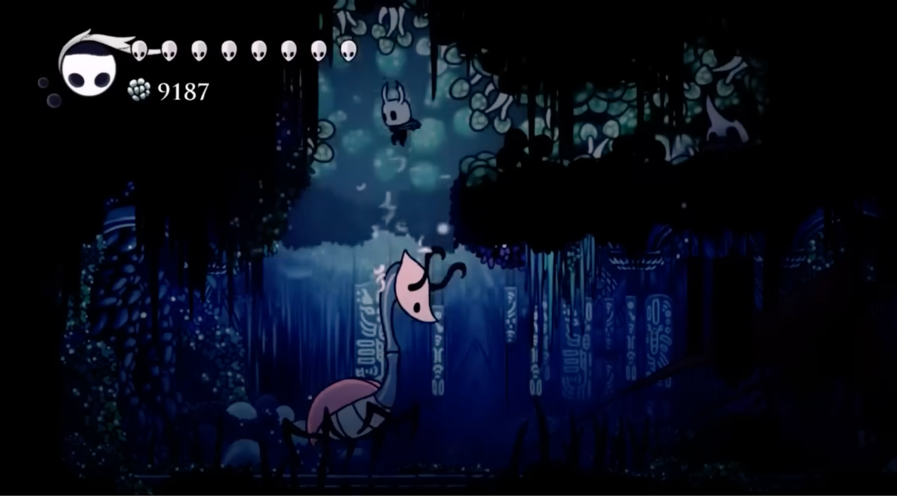
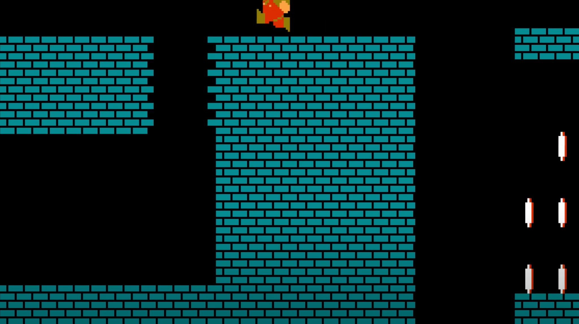
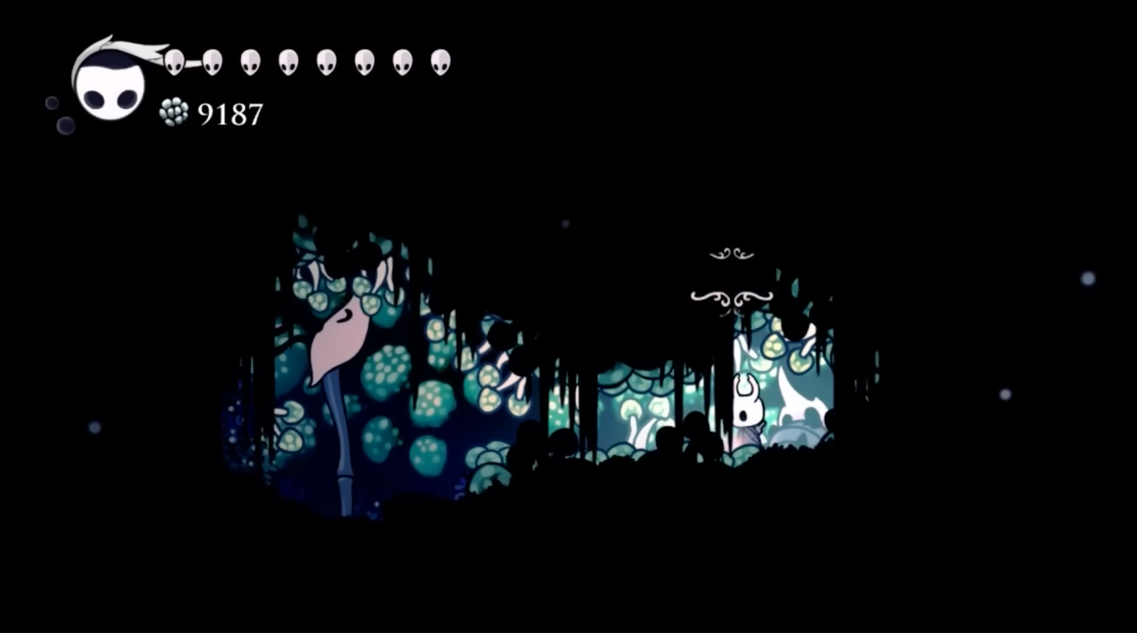
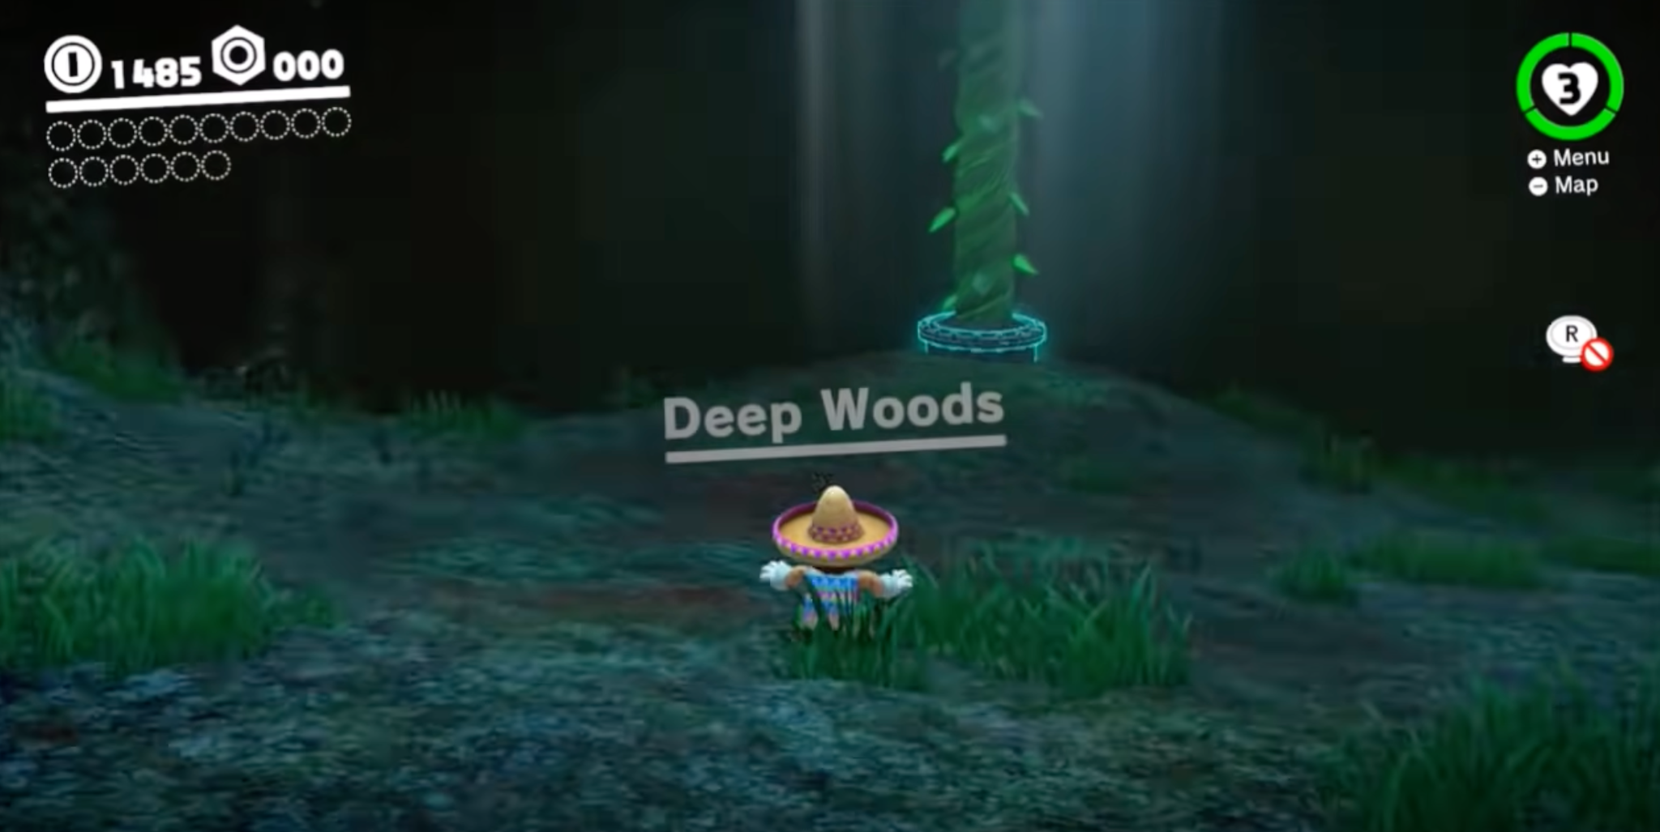



Easter Eggs: Hidden Locations
Mario 3D World
Mario Odyssey
Hollow Knight
Super Mario Bros
*Images courtesy of Team Cherry, Nintendo Co. Ltd. (left to right)
Legend Of Zelda

Slide 43




7.Flag Appearance

Slide 44

Flag tileset

Slide 45

8.Level
Constraints

Slide 46

9.Special
effects

Slide 47


Particles
Particles are tiny graphical elements used to simulate complex visual effects such as fire, smoke, sparks, rain, magic, etc…
Instead of manually animating every detail, a particle system spawns and controls hundreds of small sprites or points, each with its own properties like size, color, lifetime, and movement.

Slide 48



Particles: Examples
Minecraft
Portal
Pokemon Fire Red
*Images courtesy of Mojang Studios, Valve Corporation,
Nintendo Co. Ltd. (left to right)

Slide 49



Shaders
Shaders are small programs that run on the graphics card to control how objects are drawn on the screen.
Developers can create effects like: reflections, glowing surfaces, rippling water, or dramatic shadows.

Slide 50



Shaders: Examples
Jet Set Radio
Pokemon Fire Red
*Images courtesy of Sega Corporation, Nintendo Co. Ltd. (left to right)

Slide 51
Final thoughts and reflections

Slide 52


Explore other activities: Snake Game Design
🔗 st235.github.io/RoyalInstitution.IntroductionToGameDevelopment.v3

Slide 53



Explore other activities: Developing Snake Game
🔗 st235.github.io/RoyalInstitution.IntroductionToGameDevelopment.v2
🎥 https://docs.google.com/presentation/d/1Mjba1zi_cBy_Yj6Ie7shPmTOuNbAomML247daykqZMo/edit

Slide 54
Further reading

Slide 55

“Game Programming Patterns” by Robert Nystrom
🔗 gameprogrammingpatterns.com
Game Programming Patterns is a collection of patterns and advice the author found in games that make code cleaner, easier to understand, and faster.

Slide 56

“Game Engine Architecture” by Jason Gregory
🔗 gameenginebook.com
Game Engine Architecture covers both the theory and practice of game engine software development, bringing together complete coverage of a wide range of topics. The concepts and techniques described are the actual ones used by real game studios like Electronic Arts and Naughty Dog.

Slide 57

CS50G: Introduction to game development
🔗 cs50.harvard.edu/games/2018/
Students explore the design of such childhood games as Super Mario Bros., Legend of Zelda, and Portal in a quest to understand how video games themselves are implemented. Via lectures and hands-on projects, the course explores principles of 2D and 3D graphics, animation, sound, and collision detection using frameworks like Unity and LÖVE 2D, as well as languages like Lua and C#.
RETIRED

Slide 58

Lua programming language
🔗 lua.org
Lua is a powerful, efficient, lightweight, embeddable scripting language. It supports several programming styles: procedural, object-oriented, functional, data-driven, and data description.

Slide 59

Phaser
🔗 phaser.io
Phaser is a free, open-source JavaScript framework for making 2D games that run in a web browser. It's especially popular for prototyping.
*Image is a courtesy of Phaser Studio Inc

Slide 60
Thank you for attention!

Slide 61
Alex Dadukin
Software Engineer
*For any inquiries or questions contact Ben and he will kindly redirect them to me

